Slide 1
Activator
During the holiday season of 1996, a children's toy appeared on Good Morning America. The toy, produced by Tyco, had sat on the shelves with very little sales until it appeared on the show. After the toys appearance, its popularity improved and it became the most sought after product of the holiday season. Unfortunately, Tyco did not anticipate the doll’s popularity, only producing 400,000 units, and were not able provide the product in a timely manner at the store level (over 1,000,000 were in demand).

Slide 2
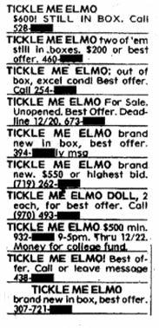
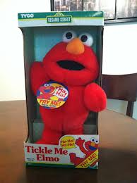
Elmo was sold for as much as $2500 through a classified ad

Slide 3
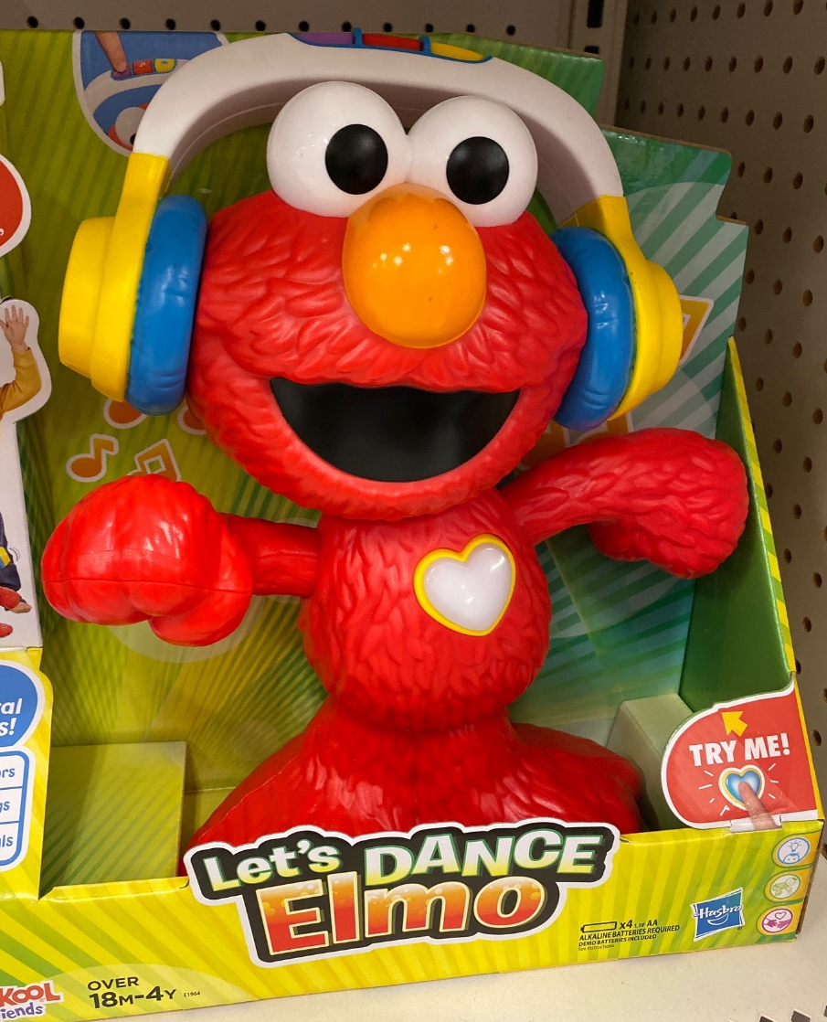
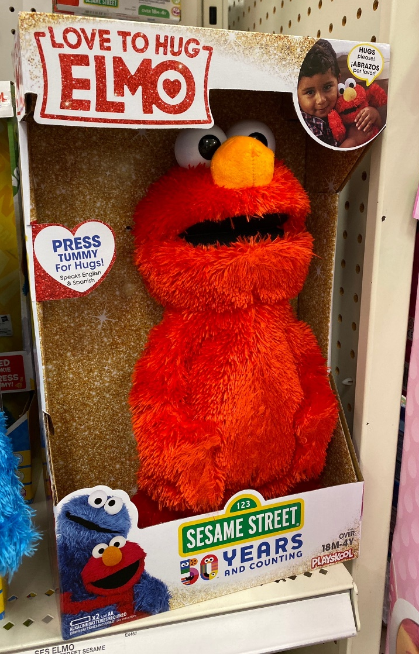
Variations on the original Elmo

Slide 4
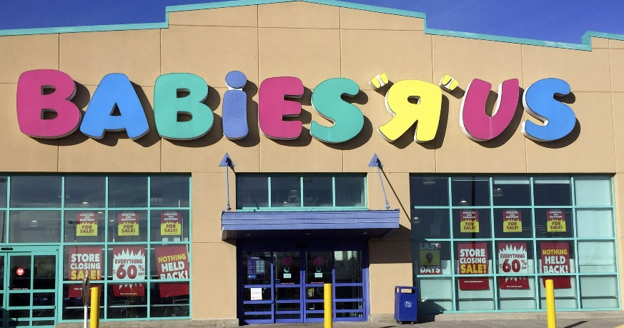
What Does This Teach Us About Economics?
High Demand for Elmo, low supply (shortage) led to an increase in market value (price).
Scarcity of time to get the product to the market, while the market had an almost unlimited desire for the product.

Slide 5
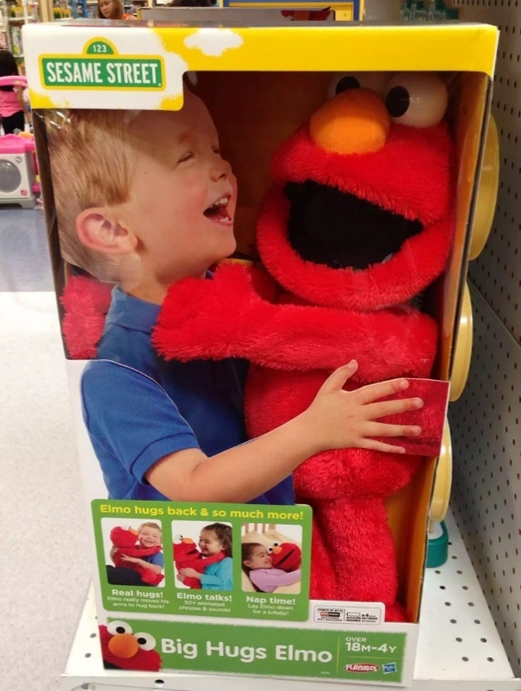
Elmo Videos
Elmo Commercial
Elmo Good Morning America
Elmo Causes Walmart Employee to be Trampled
Christmas through the Decades
5. Tickled Red
https://www.youtube.com/watch?v=2wf9lREtLvU
https://www.youtube.com/watch?v=xFCcN146WBw&list=PL0D79F5BDE2224AFA
https://www.youtube.com/watch?v=-ajNOP1UvPU&feature=youtu.be
https://www.youtube.com/watch?v=xygJE5yqQW0&feature=youtu.be
https://www.youtube.com/watch?v=pbfoXvOaY1I&feature=youtu.be

Slide 6
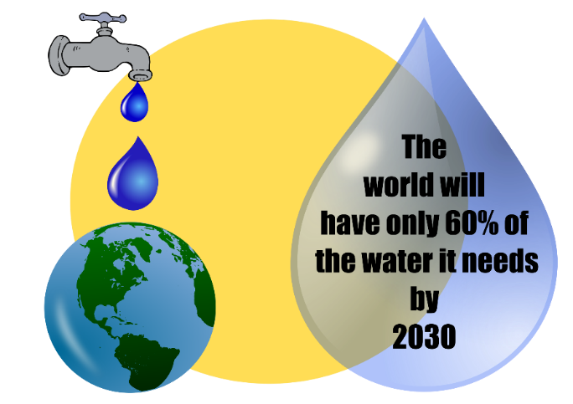
Fundamental Economic Concepts Scarcity and the Factors of Production
Scarcity – is the fundamental problem facing all people; unlimited wants and limited resources to satisfy those wants
The Basic Economic Problem:
We want more than we can have!
Humans' wants and needs are infinite, while the resources needed to satisfy those wants and needs are limited and scarce.
Scarcity
Abundance

Slide 7
Scarcity
What makes something scarce?
Something is scarce when it is both limited and desirable
e.g. - Lebron James, oil, time, rest, grass in the winter (north) etc.
Scarcity applies to everyone
Scarcity represents permanent problems that cannot be solved

Slide 8
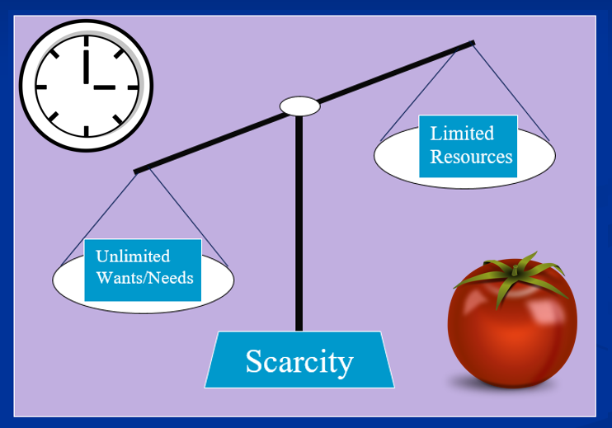
Application Question
List three things that you feel are scarce in your life, what has caused them to become scarce?
Limited
Resources
Unlimited Wants/Needs
Scarcity

Slide 9
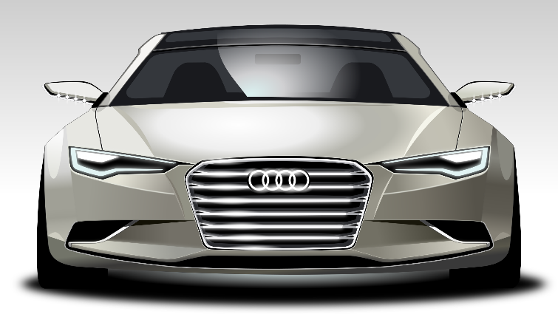
How to allocate (distribute) scarce resources in a Market Economic System Who gets the stuff?
“You got the money, you get the stuff”

Slide 10
Scarcity and Specialization We reward skills with higher pay!
Cashier Teacher Professional Athlete
$7.25 an hour $65,000 a year $21.1 Million a year

Slide 11
What is Economics?
Economics – the study of choices; how individuals and groups seek to satisfy their wants and needs in light of scarcity

Slide 12
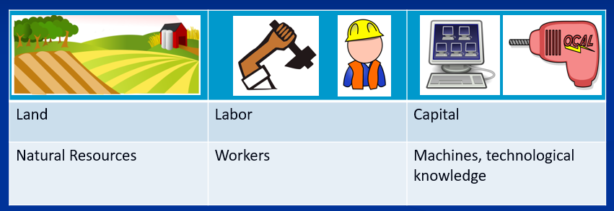
What are the resources necessary to produce? Factors of Production
Factors of Production - resources required to produce goods and services

Slide 13
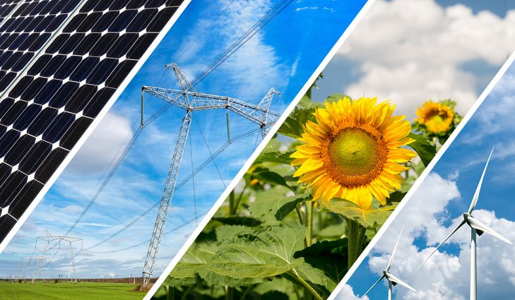
Land
Land – natural resources not created by human effort that are used to produce goods and services
The "gifts of nature".
Examples: Wind, water, natural vegetation, solar energy, and animals, etc...

Slide 14
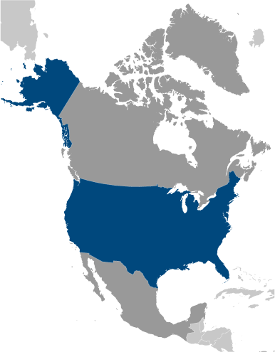
Labor
Labor – time and effort devoted to producing goods and services.
“The Workers”
Labor resources are those provided by the body and minds of men and women.
Examples: Cashier at Wal-Mart, teachers, construction workers, etc...

Slide 15
Capital
3 Types
Physical Capital – also known as Capital Goods, human made objects used to create other goods and services
Examples: Machines, phones, computers, equipment
Human Capital – skills, abilities, and specialized talents of people
Examples: College, training, technical school, etc.
Financial Capital – money, used by businesses to invest in their business
Examples: money
Physical
Human
Financial

Slide 16
Entrepreneurs
Entrepreneurs – business owners who organize the factors of production to bring stuff to the market
Entrepreneurs are the "risk takers" who produce a good or service that they believe will succeed in the marketplace.

Slide 17
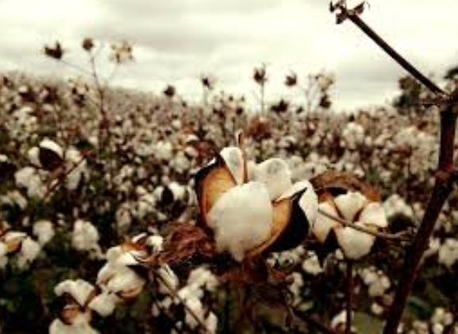
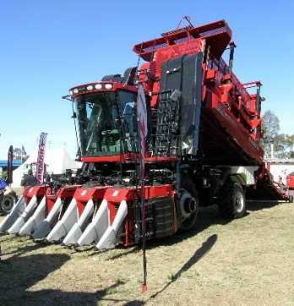
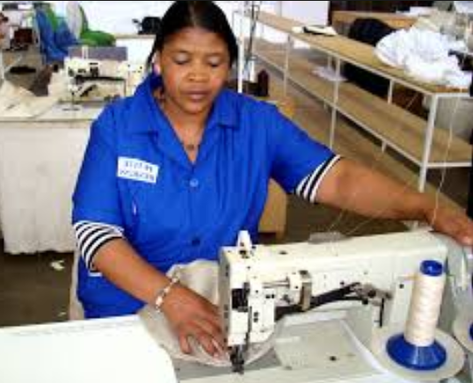
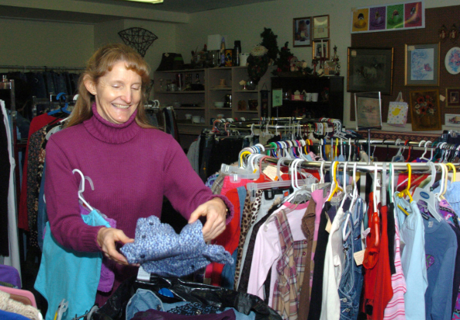
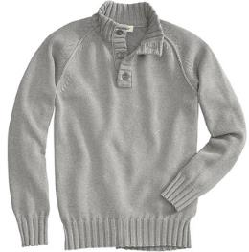
Factors of Production
Land
Capital
Labor
Entrepreneur
+
+
+
=

Slide 18
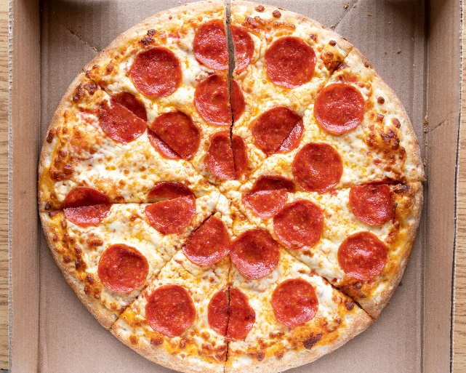
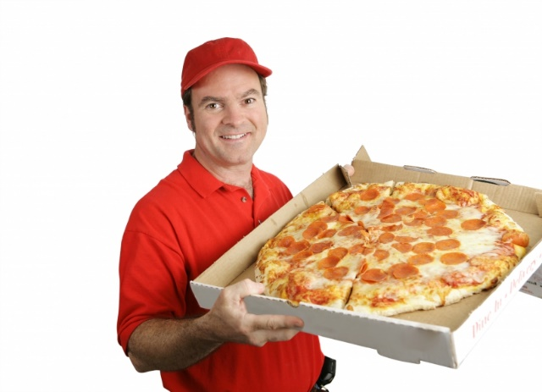
Classify the Factors of Production in the following scenario:
You decide to order a pizza to satisfy your wants. First, you enter your order on your cellphone with the company’s app, which shows up on the computer monitor at the local business owner’s pizzeria. The information is queued on the pizzaiolo’s (pizza maker) company iPad in the kitchen. He immediately begins working on the pizza by using his knowledge of mixing dough out of salt, flour, eggs, and milk. The pizzaiolo finishes mixing the dough and takes a moment to wash his hands in the sink. The cook then prepares your pizza using the necessary ingredients including, tomato sauce, cheese, red bell peppers, pepperonis, and spinach. He then places the pizza in the brick oven. After 20 minutes, the pizza is ready to be delivered. He grabs the pizza and hops into the company car and delivers it to your door.

Slide 19
Examples of Factors of Production
Land | Labor | Capital | Entrepreneurs
1. | 1. | 1. | 1.
2. | 2. | 2. | 2.
3. | 3. | 3. | 3.

