Slide 1
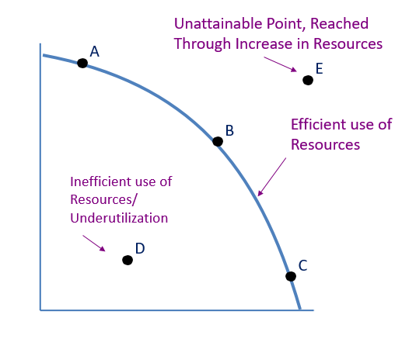
Production Possibilities Model
What is the PPC Model?
PPC Model – shows/illustrates the possible combinations of goods and services that can be produced by a single nation, firm or individual given the productive resources available
What does it show?
That nothing is free and that everything has an opportunity cost
If society wants more of one thing then it must give up something in return
Used to visually represent opportunity cost

Slide 2
Basics of the production possibilities frontier model
Currently unattainable point
A
E
B
Efficient use of
resources
Inefficient Use of Resources/
Underutilization
D
C
1,000

Slide 3
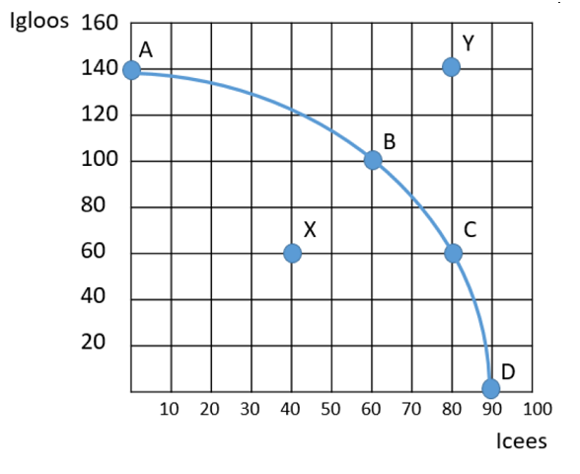
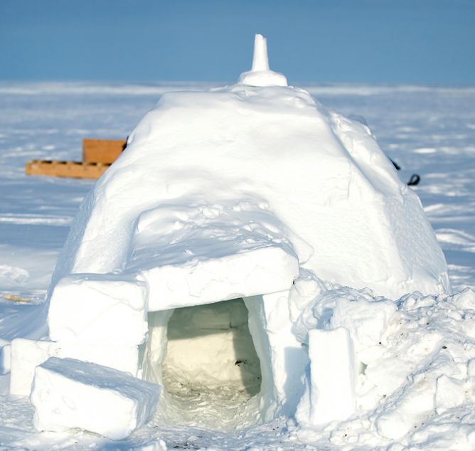
Production Possibilities Model
What basic economic concepts can it be used to model?
Scarcity
Tradeoffs
Opportunity cost
Economic growth
Efficiency
Unemployment
or

Slide 4
Production Possibilities Frontier Model
Individual PPF – Individual tradeoffs
Constant opportunity cost - linear shape of the curve represents a perfect/proportional tradeoff between two goods
Work
A
1 Hour
B
30 Min
C
0
30 Min
Play
1 Hour

Slide 5
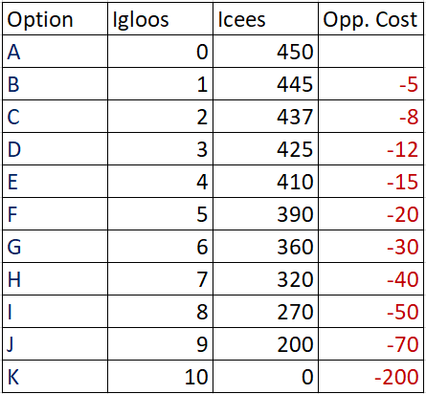
Increasing Opportunity Costs
Increasing Costs

Slide 6
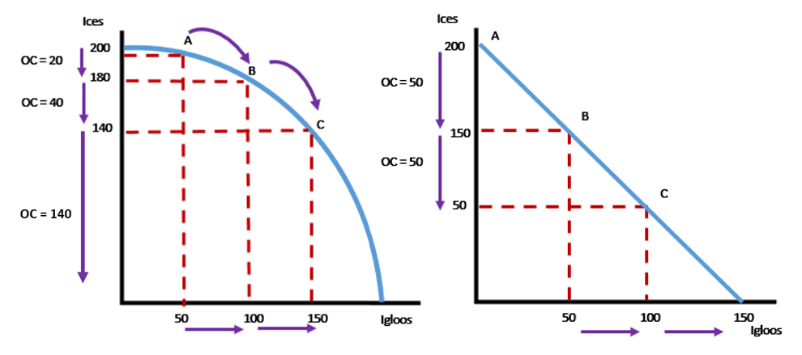
Increasing Opportunity Costs
Constant Opportunity Costs

Slide 7
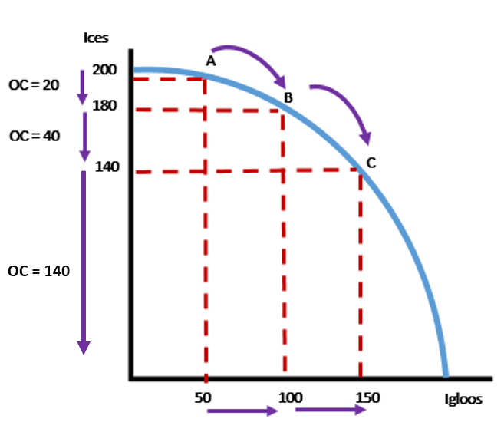
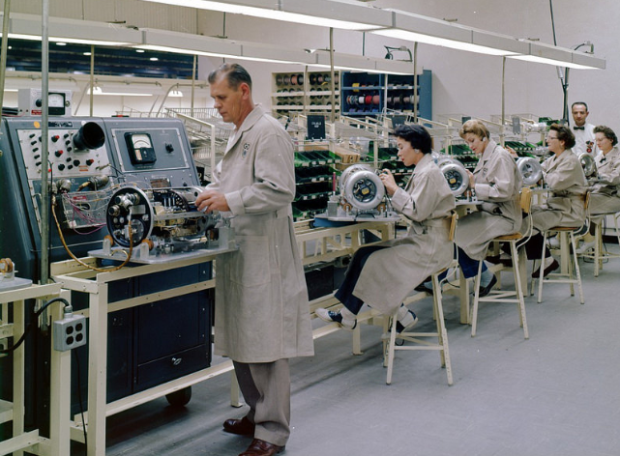
Production Possibilities Curve
Efficient – maximum production; using resources wisely
Points along the curve, (a – c)

Slide 8
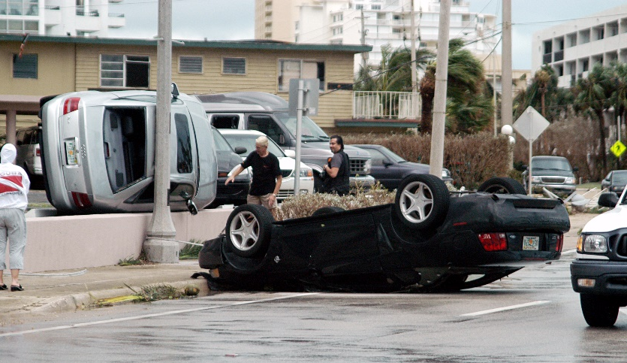
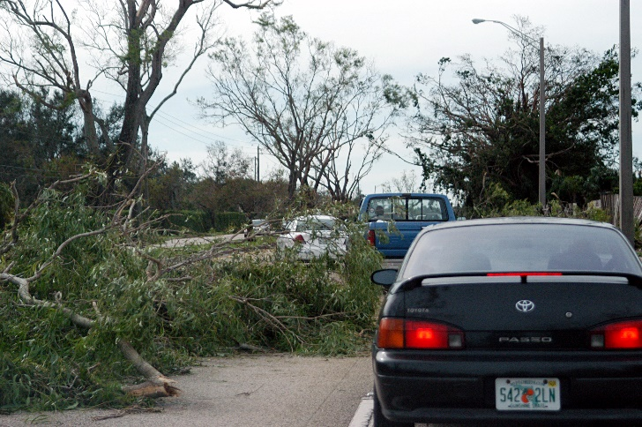
Underutilization (Inefficiency)
Underutilization – less than maximum production; using fewer resources than a person/economy/business is capable of.
Points inside the curve, d (inefficient use of resources)
Underutilization /Inefficiency
Aftermath of Hurricane Wilma
d

Slide 9
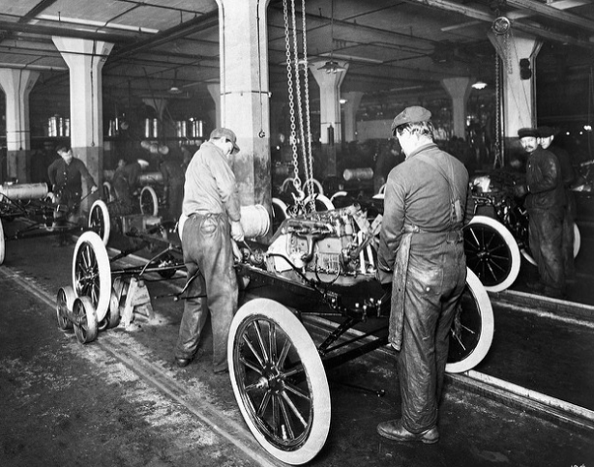
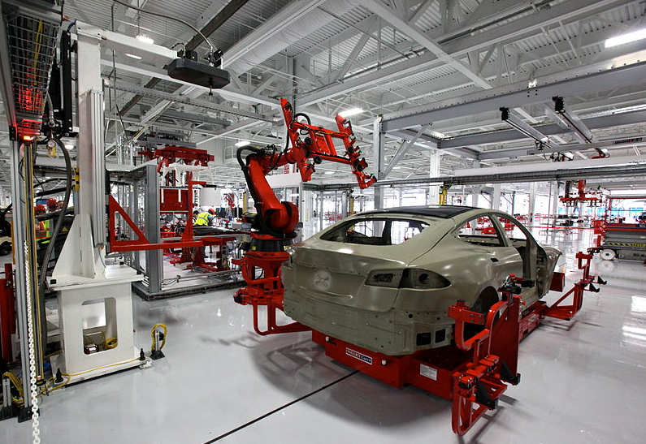
Unattainable Point
Unattainable Point– currently unreachable point of production
Only reached through more efficient resources
Currently Unattainable
y

Slide 10
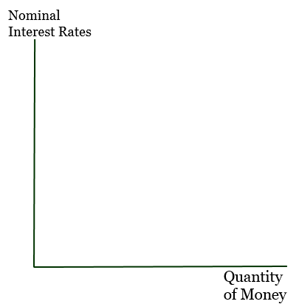
Shifts in the PPF
Decrease in Resources
Increase in Resources

