Slide 1
RiCHARD NIXON & WATERGATE

Slide 2
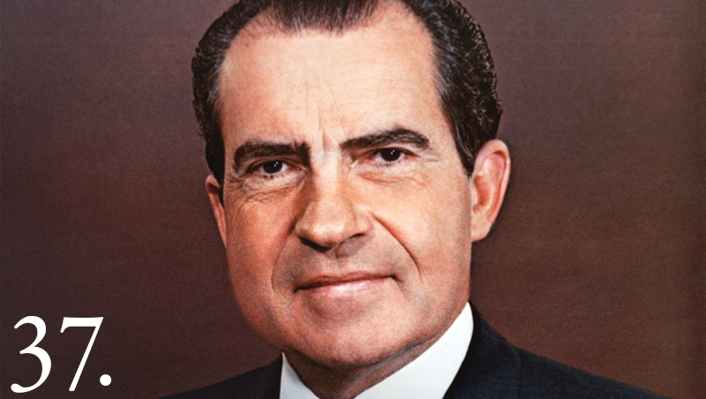
Objective
Discuss the successes and failures of Richard Nixon by creating an Epitaph for his presidency.
You will evaluate if he was a good president or not.

Slide 3
Richard Nixon
Political Party: Republican
President: 1969-1974
The first and only president to RESIGN!

Slide 4
July 1970:
Nixon proposes the Environmental Protection Agency. This new government agency aimed to protect human health and the natural environment.

Slide 5
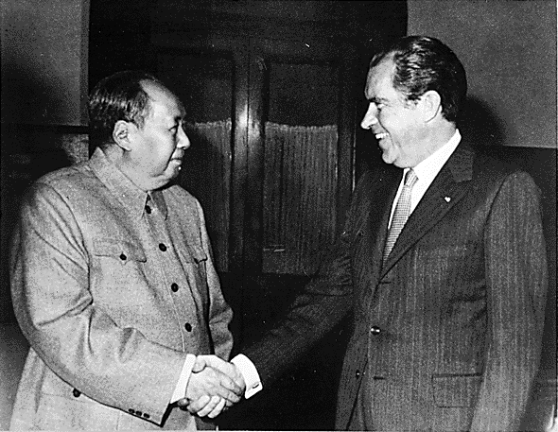
February 1972
Nixon visits China. As part of the policy of détente, Nixon hoped to establish friendly diplomatic relations with communist China and isolate the Soviet Union.

Slide 6
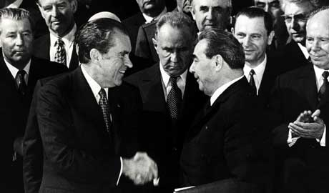
May 1972
Nixon signs the Strategic Arms Limitation Treaty. This five-year agreement with the Soviet Union limited the number of nuclear missiles each country had in its arsenal.

Slide 7
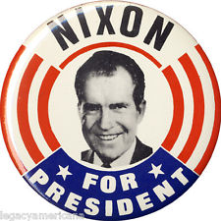
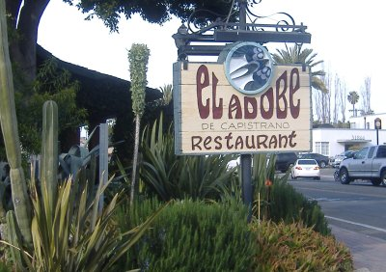
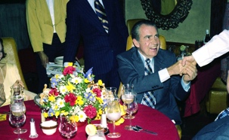
A couple things you should know
He came from California.
Humble background, rose up on his own.
Congressman, Senator, Vice President. Lost race for President in 1960

Slide 8
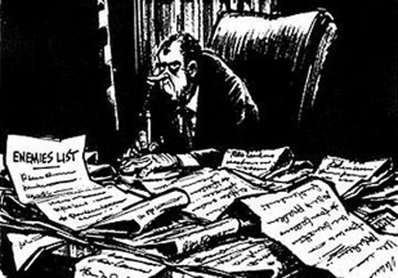
A couple things you should know
Very paranoid, thought people were out to destroy him
Kept an enemies list, wiretapped and spied on reporters, civil rights activists, black panthers, anyone who he distrusted.
The “Plumbers:” A White House organization dedicated to stop secret information from leaking out.

Slide 9
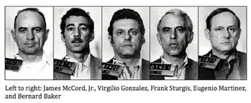
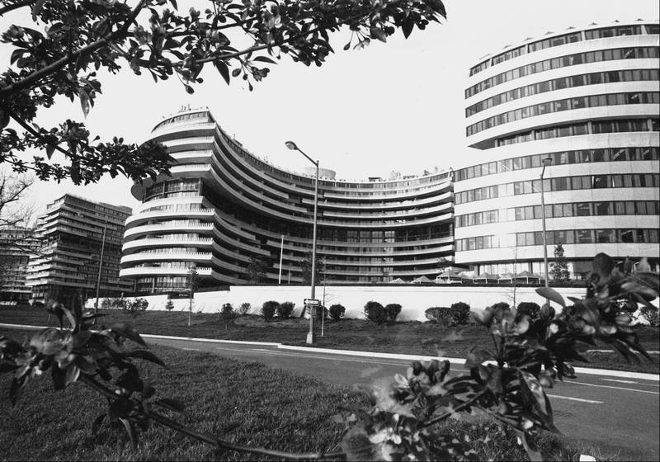
June 1972
A break-in at the Watergate Hotel in Washington DC, the headquarters of the democratic party, was stopped. There was attempted wiretapping and spying on the Democrats. Nixon denounces it.

Slide 10
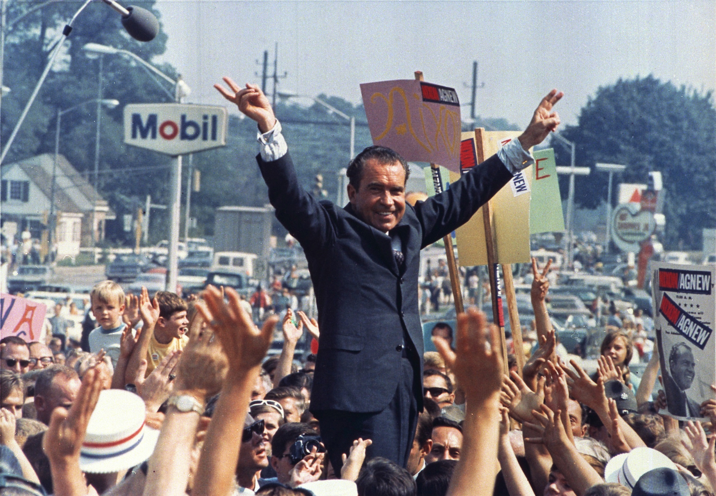
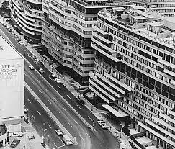
november 1972
Nixon wins reelection by a landslide, despite the Watergate break in.

Slide 11
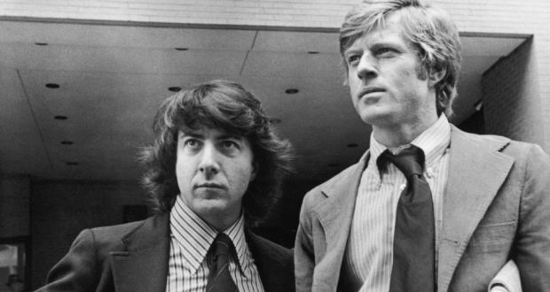
July 1973
Reporters Woodward and Bernstein were leaked information by a secret source connecting Nixon’s Reelection Committee to paying The “Plumbers” to wiretape the Watergate.

Slide 12
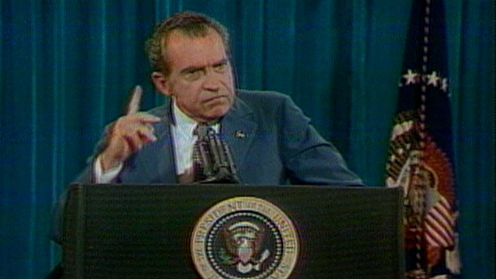
July 1973
The Senate subpoenas (orders) Nixon to release recorded tapes of conversations between Nixon and his reelection committee (The White House Tapes). Nixon refuses, states executive privilege, or the right of the president to not have to ask congress to do everything.
I’m not a crook!

Slide 13
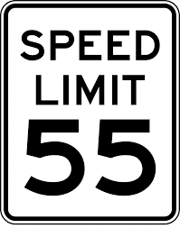
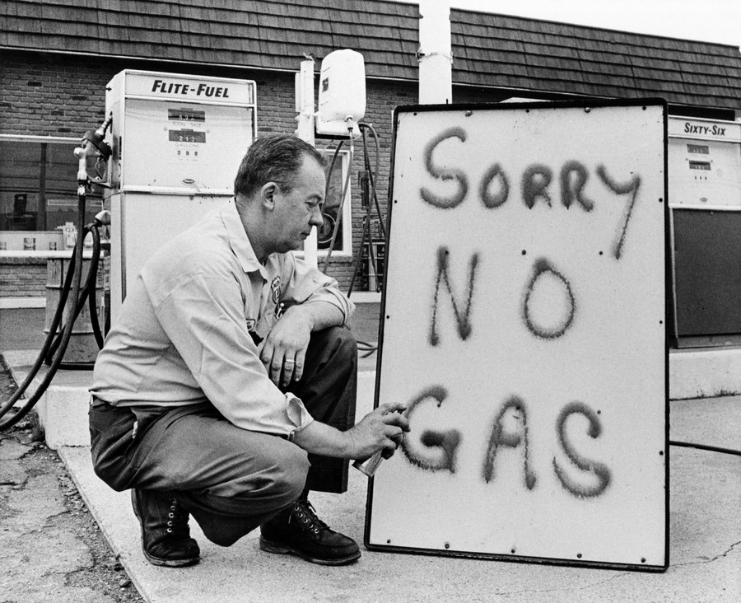
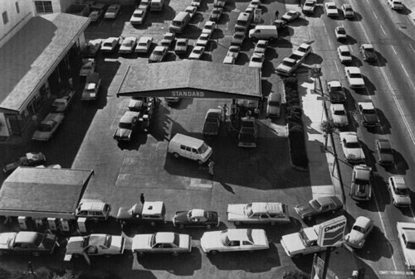
October 1973
The Organization of Petroleum Exporting Countries (OPEC) punished the US for supporting Israel against Arab nations. They stopped shipping oil to the US resulting in an energy crisis. Gas prices rose, gas stations simply ran out, and the speed limit was reduced to 55mph.

Slide 14
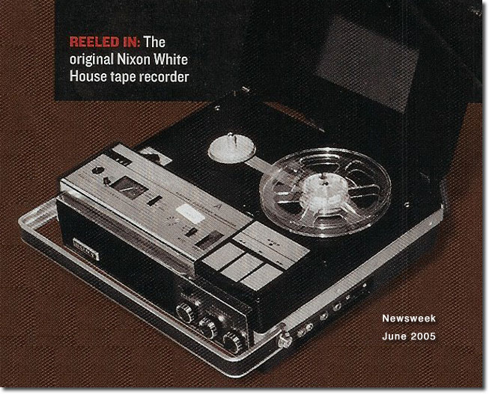
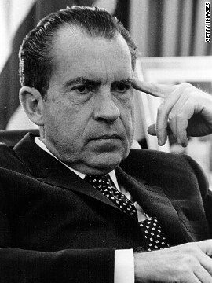
July 1974
The Supreme Court, in the case US vs. Nixon, ruled that Nixon must release the tapes to congress. Revealed connections between Nixon and Watergate. Several parts were erased

Slide 15
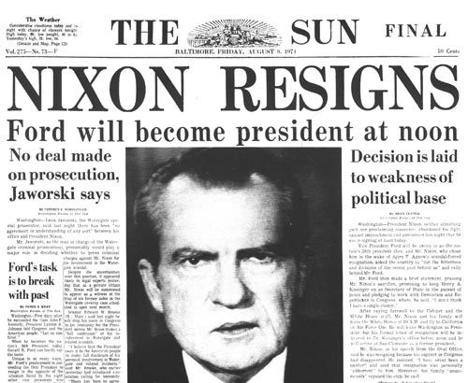
August 1974
Congress begins the process of impeachment on the counts of obstruction of justice and abuse of power. Nixon resigns from the presidency.

Slide 16
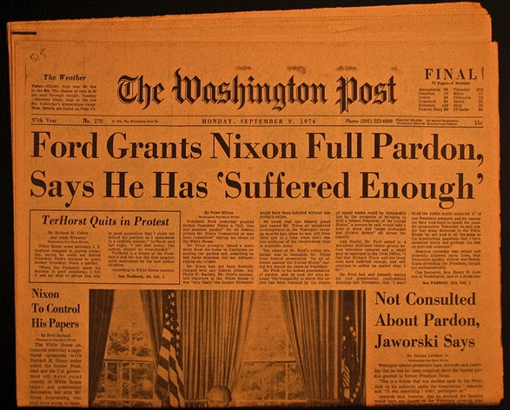
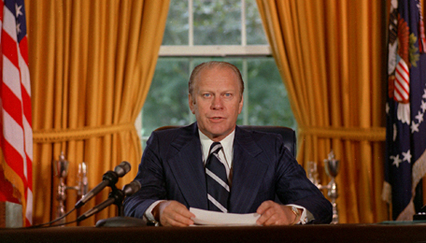
September 1974
President Gerald R Ford pardons Nixon for Watergate in order for the nation to move on. Many angry because they wanted Nixon go to trial. Leads to massive distrust of politicians and the government.

Slide 17
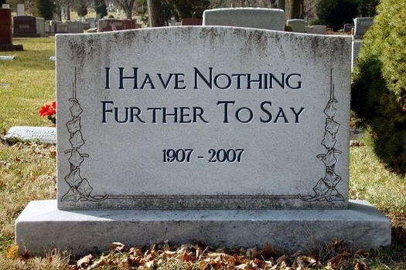
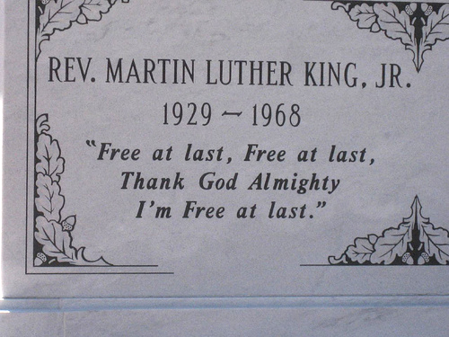
Summative Assignment
Design an epitaph (gravestone) for Richard M. Nixon’s presidency commenting on his achievements as president. The Epitaph is the part engraved in the tombstone. You should include
His Name (duh….) 1 pt
His time in office. 1 pt.
A descriptive phrase or title that highlights his accomplishments and his controversies (example, skillful politician or disgraced president) 2 pts.
A short poem that refers to two events that were of a positive legacy and 2 events that damaged his legacy (2 pts)
Two or more images that illustrate details in the poem (1 pts)
Other clever touches to make it more interesting (1 pt)

