Slide 1
How does the New Deal affect us today?
TCI Ch 33

Slide 2
Add to your Notebook
The Legacy of the New Deal 4

Slide 3
Legacy of the New Deal
The Welfare State (Safety net to protect us)
Big Government (More laws and regulations to regulate our government)

Slide 4
First New Deal
Restructured the Banks to give confidence to bakers, lenders, lendees (AKA new laws to make sure banks were fair to lenders & money was safe in banks)
Paid farmers not to plant to raise prices and stop overproduction
Promote homeownership
Remember the “Forgotten Man”
Notes:
Have a list of agencies available

Slide 5
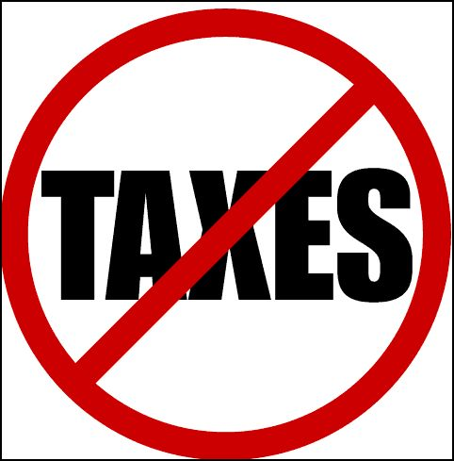
Conservatives against the New Deal
The New Deal gives the government too much power. (Higher Taxes, More Laws)
American Liberty League formed to oppose the New Deal

Slide 6
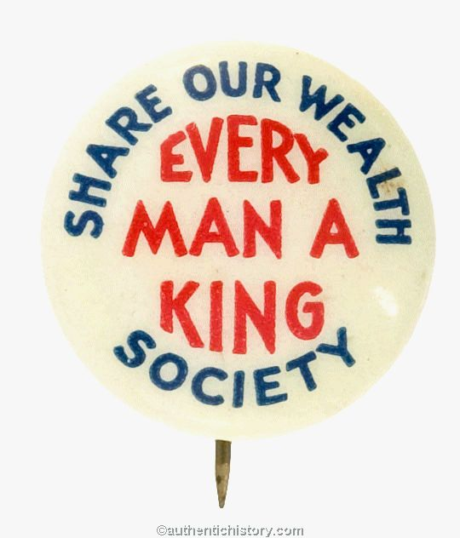
Liberals against the New Deal
Some liberals thought the New Deal didn’t do enough
Huey Long & “Share our Wealth”
wanted everyone to have guaranteed job and income.
Charles Coughlin
Roosevelt not doing enough
Wall St. = Evil

Slide 7
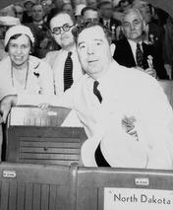
Huey Long
How many of you ever went to a BBQ and took 9/10th of the food people are supposed to eat? The only way to feed the rest is to have that person bring back the grub that he ain’t got no business with!
- Share Our Wealth Speech

Slide 9
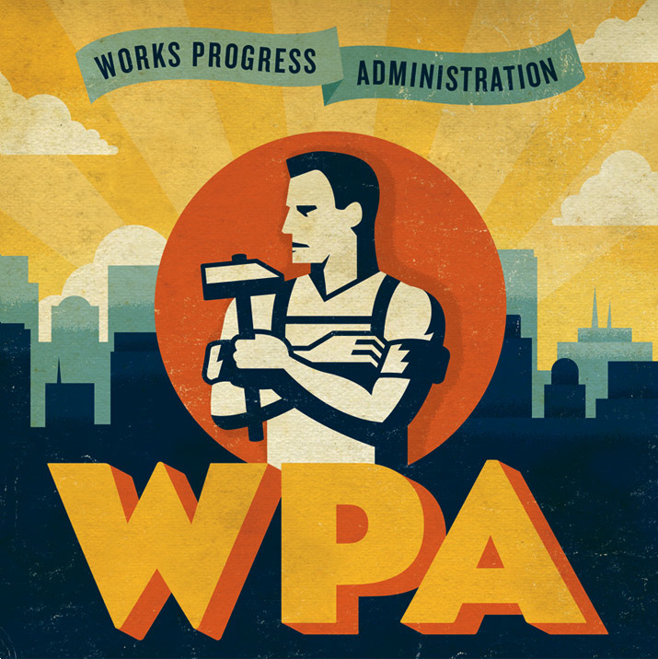
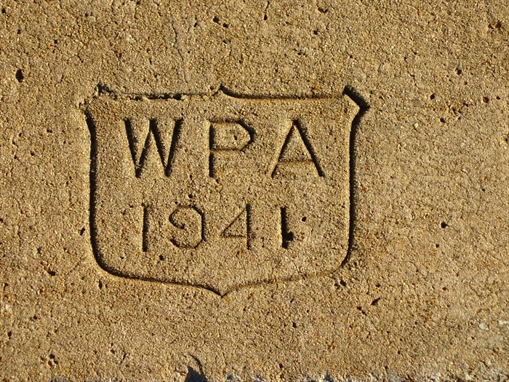
Second New Deal
Works Progress Administration
Construction Projects
Parks
Art Projects

Slide 10
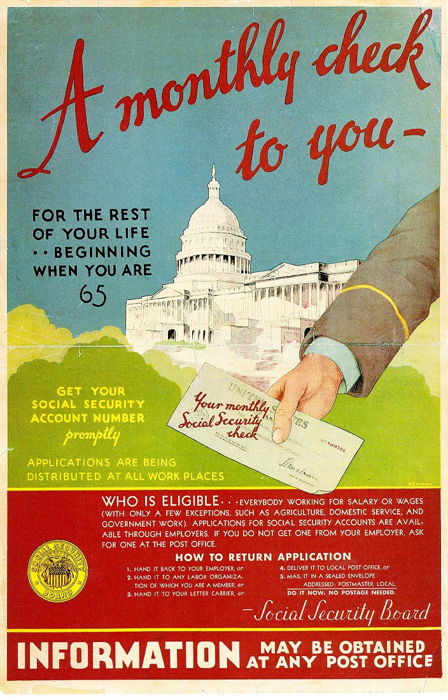
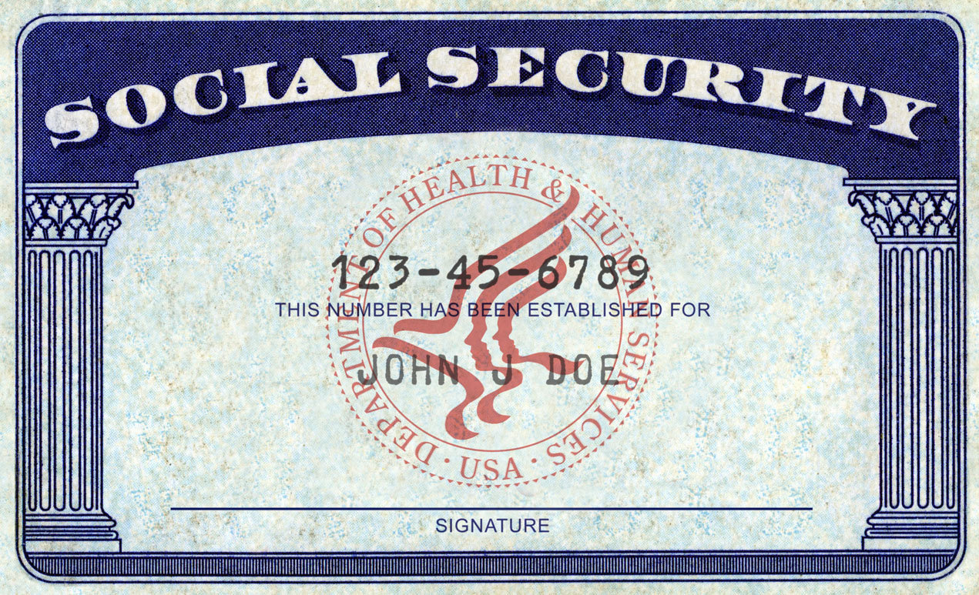
Second New Deal
Social Security
Cash Payments to Retired and Disabled
Unemployment Insurance

Slide 11
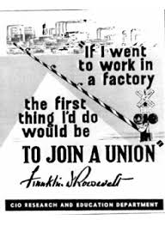
Labor Movement
Wagner Act (Make it easier to form Unions)
National Labor Relations Board (NLRB)
regulated activity between workers and management (make sure both sides played fair)

Slide 12
Labor Movement
Congress of Industrial Organizations (CIO)
Large labor Union based on Industry (pilots, auto workers), rather than craft (bakers,

Slide 13
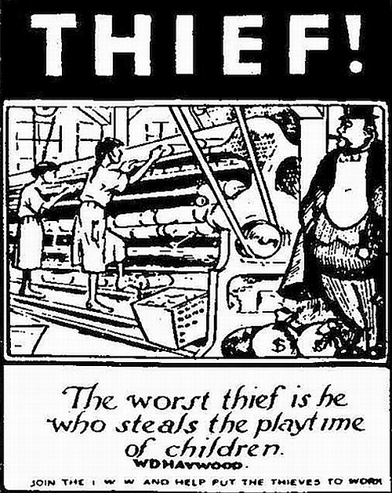
Labor Movement
Fair Labor Standards Act
Minimum Wage/40 Hour Week/Overtime/Bans Child Labor

Slide 14
Is the New Deal Constitutional?
1935: Some Programs (AAA) (NIRA) found unconstitutional.
Government can’t control prices. Only businesses can set prices.
Courtpacking: FDR attempted to add liberal judges to the court that supported him (failed)

Slide 15
Is the New Deal constitutional?
1937: Social Security and Wagner Act were declared constitutional
Old thinking: Freedom = Make Money/Do what you want
New Thinking: Freedom = Safety Net

Slide 16
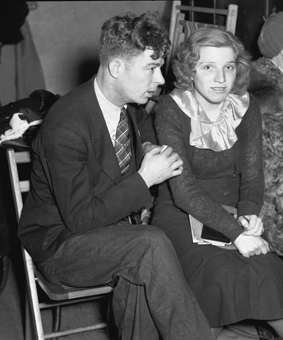
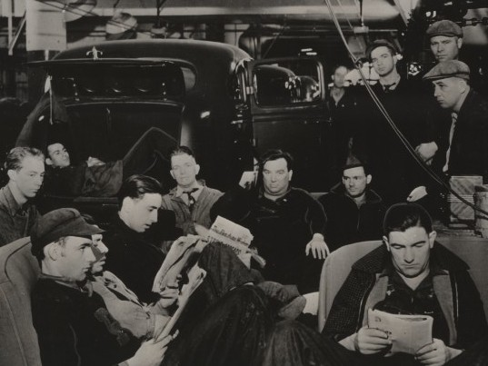
Workers Benefit
Labor Unions grow in power and numbers.
United Auto Workers sit down strike @ General Motors
Government takes side of workers

Slide 17
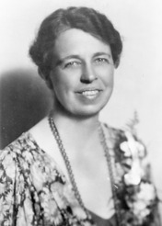
Mixed bag for Women
Government hires more women.
Frances Perkins, Labor Secretary, first Female Cabinet Member.
Many companies wouldn’t hire
married women.

Slide 18
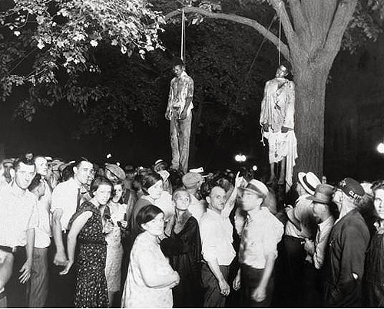
Disappointing Deal for African Americans
FDR refused to support an Anti Lynching law, afraid he would loose southern support.
No Southern Support = No New Deal

Slide 19
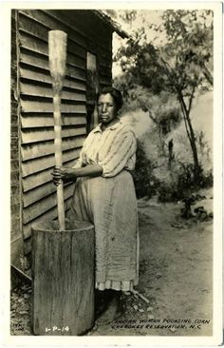
OK Deal for American Indians
Before: Extreme Poverty and Forced Assimilation
Indian Reorganization Act gives Indians right to organize their own tribal governments (Didn’t end poverty)

Slide 20
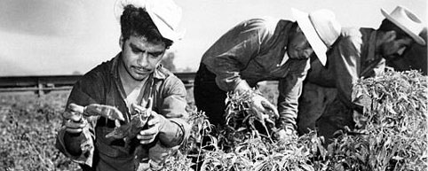
Tough Deal for Mexican-Americans
Many worked as farmers
AAA cut productions and raised prices, led to unemployment for the workers.

Slide 21
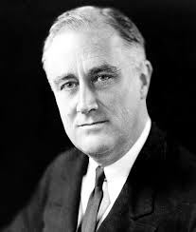
New Deal Coalition
All these groups supported Roosevelt
President for 4 terms (longest ever)

Slide 22
New Deal Mural
In your groups, you will create panels for a mural to explain how government expansion during the New Deal affected Americans. Each group will illustrate a particular topic.

