Slide 1
Introducing America’s Ideals

Slide 2
All Americans are considered Equal

Slide 3
Some Americans have more rights than others

Slide 4
We have a lot of Freedoms in the United States

Slide 5
We have the opportunity in the United States to live our wildest dreams

Slide 6
Rich $ People have a more powerful voice in the USA

Slide 7
Introduction:
Declaration of Independence:
Thomas Jefferson: “all men are created equal with certain unalienable rights”
Life
Liberty
The Pursuit of Happiness
Thomas Jefferson envisioned a nation based on ideals
These ideals have evolved since Jefferson introduced them

Slide 8
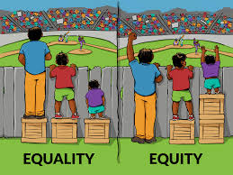
Equality
Where all are treated the same
Equality is NOT the same as equity. How do we make sure everything is equitable?

Slide 9
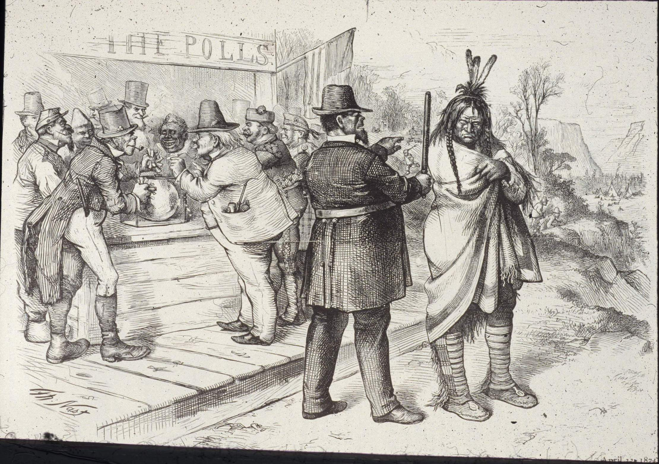
The Founding Ideals: Rights
DEFINITION
Rights are powers or privileges granted to the people by law
People have natural rights when they are born
Life, liberty and property
Government must protect these rights
Free Expression, Right to Bear Arms, Right to Vote, Right to Safety? Right to Healthcare?

Slide 10
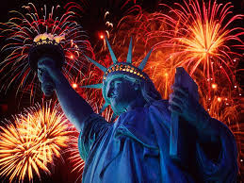
The Founding Ideals: Liberty
DEFINITION
Liberty = Freedom
Political, religious and civil freedoms
There is no absolute liberty
We must follow laws and respect others liberties as well if we want to live in a safe society

Slide 11
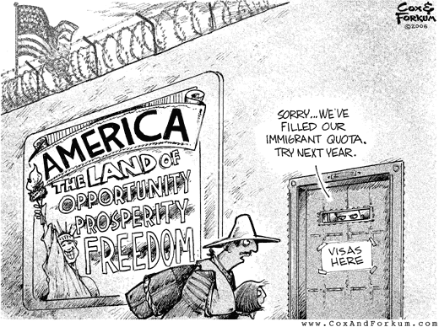
The Founding Ideals: Opportunity
The Ability to achieve your dreams
Do some have more opportunities than others? Is there a level playing field?

Slide 12
The Founding Ideals: Democracy
DEFINITION
Democracy: power to rule comes from the consent of the governed
The right to vote
Who gets to vote?

