Slide 1
Foreign Policy
TCI Ch. 19

Slide 2
DO NOW PARTY w/ JASIEL and IVETTE (2) & JUAN, MIGUEL, OZZIE (6)
On Edmodo answer these 2 questions.
What do you HAVE to do later today?
What do you WANT to do later today?

Slide 3
Add to your Table of Contents
Imperialism Introduction Video 1
US Foreign Policy (Realism vs. Idealism) 2

Slide 4
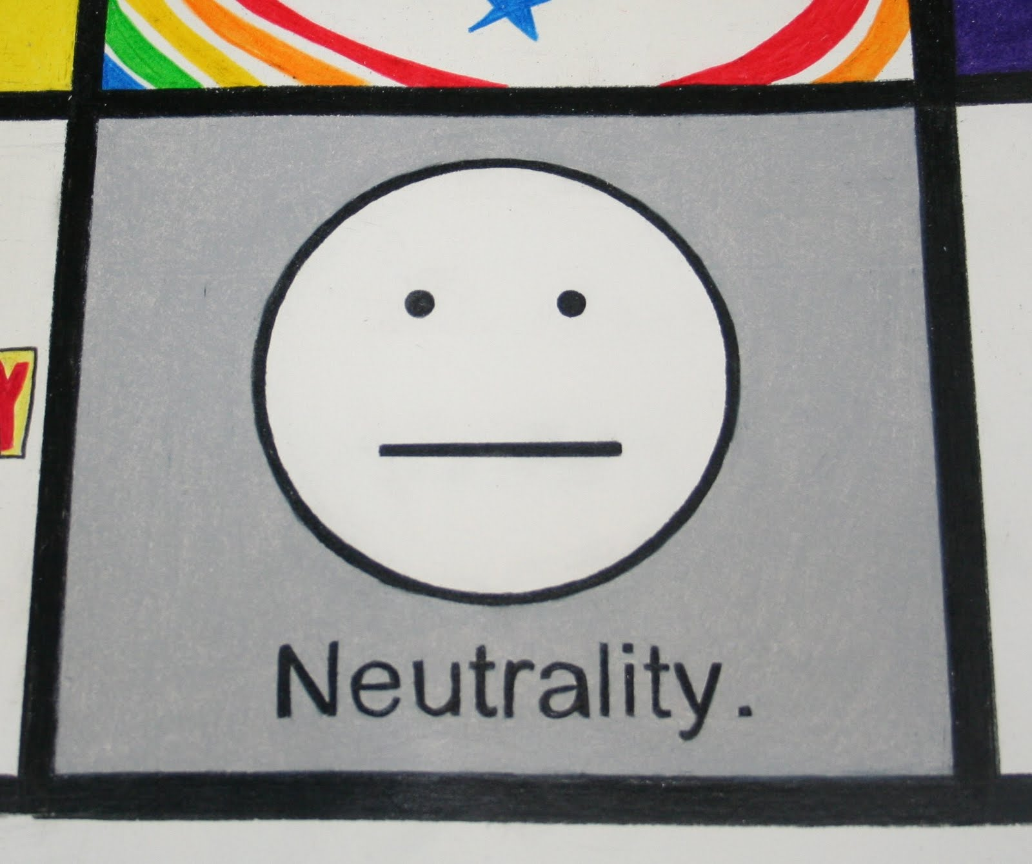
Neutrality and Unilateralism
Neutrality: Not taking Sides
Unilateralism: Not making alliances with other countries

Slide 5
War of 1812
War with Britain over kidnapping American Sailors and Seizing of American goods.
Motivations: Defend US right to trade? Perhaps capture Canada. Stand up for oneself?
Idealism or Realism? (DISCUSS!)

Slide 6
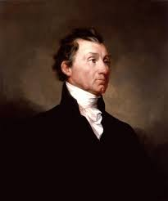
Monroe Doctrine (1823)
President James Monroe:
The Americas are closed to colonization by Europeans
Any attempt of Europe to interfere in Americas = threat to US

Slide 7
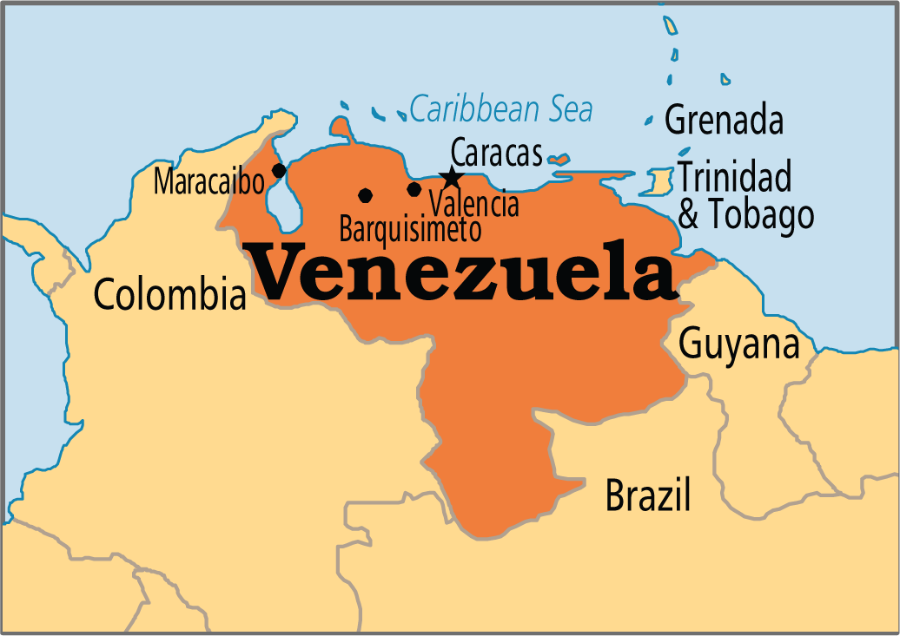
Venezuelan Border Dispute
Britain and Venezuela conflict over border w/ Guyana (British Colony. America steps in to solve the problem
Motivation: Monroe Doctrine, Protect US trading and flex muscle as a major power in Americas.

Slide 8
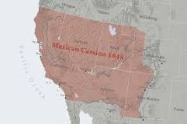
Mexican American War 1846
US Declares war on Mexico over territory. US gains the entire Southwest from Mexico
Motives: Belief in Manifest Destiny, that America was destined to go “from Sea to Shining Sea”

Slide 9
Imperialism
Building an Empire beyond the borders of a nation.
Material Goods, Markets, and belief of “spreading civilization”
Acquisition of Samoa: US gains protective status over Samoa.

Slide 10
Evaluate US Imperialism
1. Was the US right or wrong for becoming an Imperial Power?
Agree with one of the thinkers below and write why
Write why one of the other thinkers is wrong.
Evidence: Alfred Mahan, Carl Schurz, Henry Cabot Lodge, Josiah Strong

