Slide 1
Add to you rfolder
Immigration Experience (TCI Lesson 15) 6

Slide 2
Why Immigrate/Why Leave?
Pull Factor: -> Reasons to go to America
Jobs, start a new life, freedom.
Push Factor: -> Reasons to leave native country
Starvation (Irish Potato Famine)
Religious persecution (Jews in Russia)
Unemployment (Italy, China, Mexico, Quebec)

Slide 3
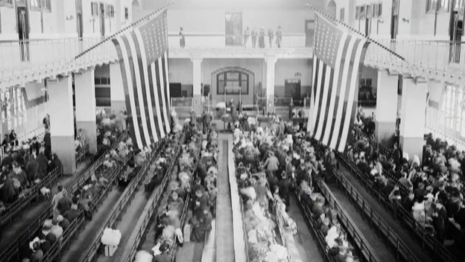
Ellis Island (East Coast)& Angel Island (West Coast): Processing Center for Immigrants

Slide 4
Ethnic Neighborhoods: “Little Italy” “Chinatown” “Lower East Side”
people with the same language and culture

Slide 5
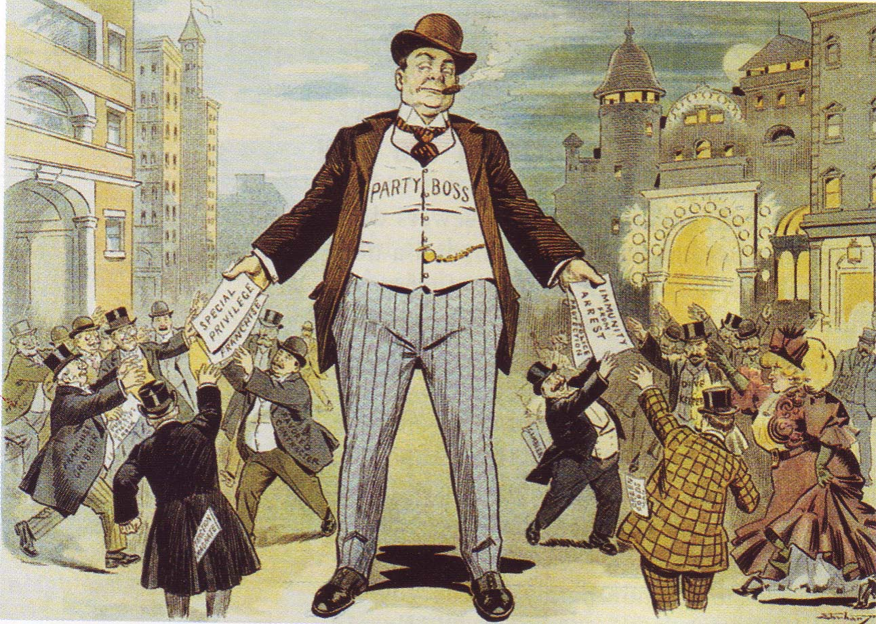
Political Bosses
Provided jobs for immigrants in exchange for votes.

Slide 6
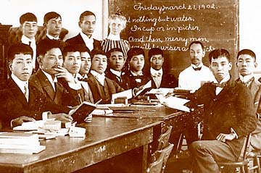
Americanization “To become American”
Notes:
RELOOK

Slide 7
NATIVISM “Anti-Immigrant”

Slide 8
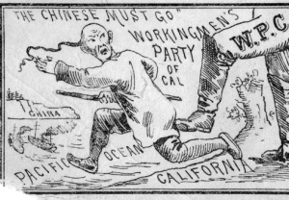

Slide 9
Nativism
Chinese Exclusion Act (1882)
Banned Chinese Immigration.
blamed for white unemployment

Slide 10
For your Poster
Each “Sense” should be minimum 2 sentences.
Bad Example “In my hands, I hold a purse because I keep stuff in it”

