Slide 1
Fighting the Cold War at Home
TCI Ch. 40

Slide 3
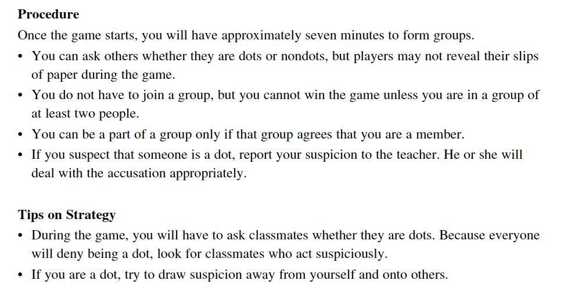

Slide 4
Add to your notebook
Fighting the Cold War at Home (TCI 40) 3

Slide 5
Essential Question
How did the Cold War affect US domestic policy and American society?

Slide 6
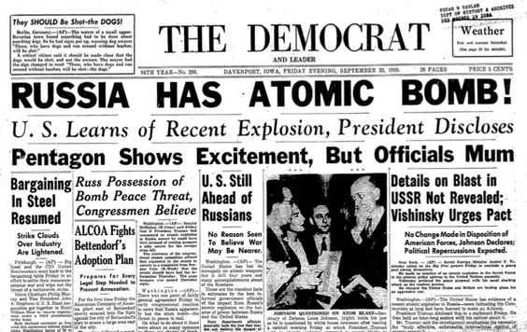
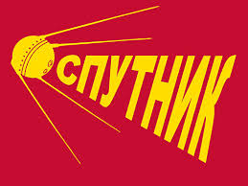
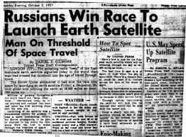
Background
1949: Soviets test first Atomic Bomb
1957: Soviets launch
“Sputnik,” 1st successful
satellite

Slide 7
Communist Sympathizer
Definition
A person who believed in communism, but didn’t join the Communist Party.
Affect
Many supported Communist ideas during Great Depression, to make everyone more equal. They were accused of being disloyal

Slide 8
House Un-American Activities Committee (HUAC)
Definition
Investigated groups to see if there were communists or communist sympathizers
Effect
Movie Studios blacklisted suspected communists (Hollywood 10), banned them from working and produced anticommunist propoganda. In 1957 the Supreme Court ruled ruled against HUAC

Slide 9
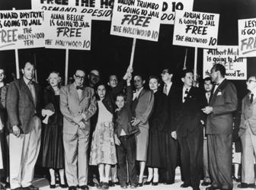
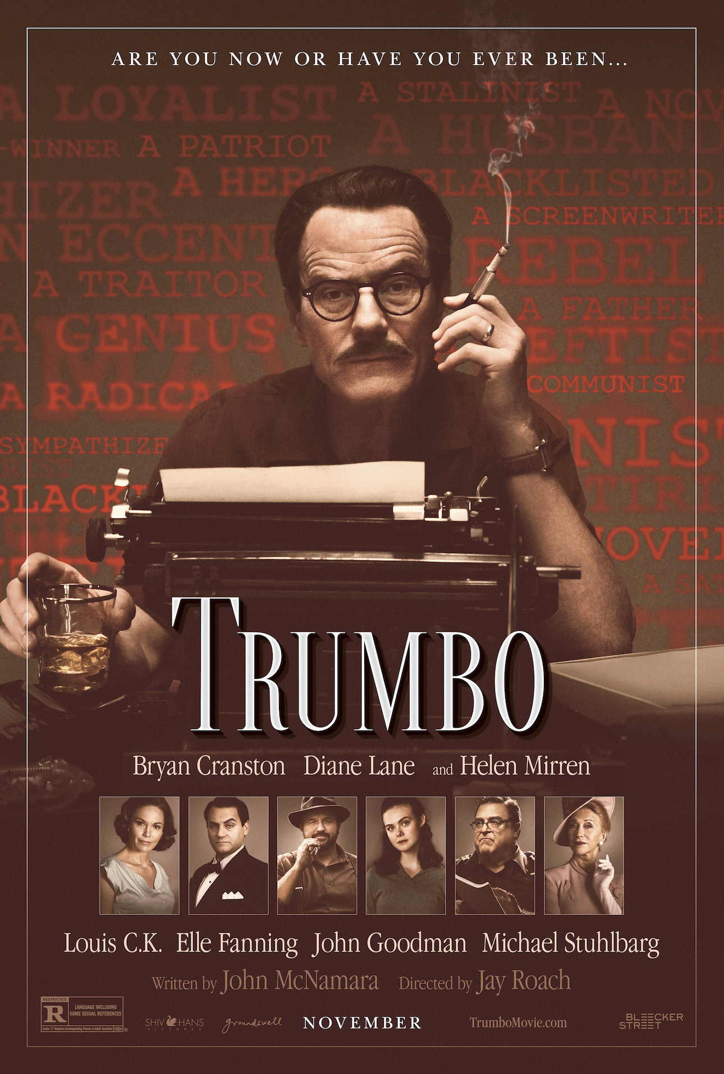
Hollywood 10

Slide 10
Discussion
1957: Supreme Court ruled that HUAC can’t investigate personal lives to that extreme. Which Amendment(s) does it violate?
Freedom of Speech
Right to bear Arms
No Quartering of Troops
No unwarranted searches or seizures
No Double Jeopardy/Can’t testify against oneself
Rights of the accused for a fair criminal trial
Rights of the accused for a fair civil trial
No Cruel or Unusual Punishment
Rights not listed in the constitution belong to people
Laws not listed are reserved to the states.

Slide 11
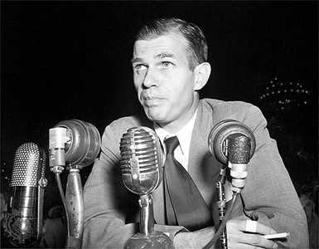
Alger Hiss Case
Definition
Alger Hiss worked for the government under Roosevelt and accused of being a spy
Effect:
People scared
That there were spies
In the US

Slide 12
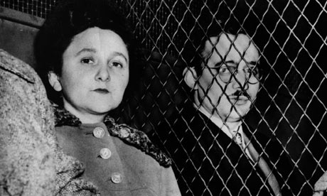
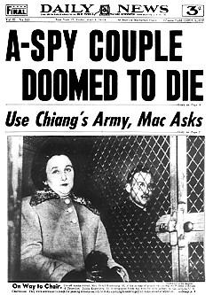
Ethel and Julius Rosenberg Trial
Definition
Found guilty of giving out information about the Atomic Bomb to Soviets. Sentenced to Death.
Effect
Some began to question if going to far…

Slide 13
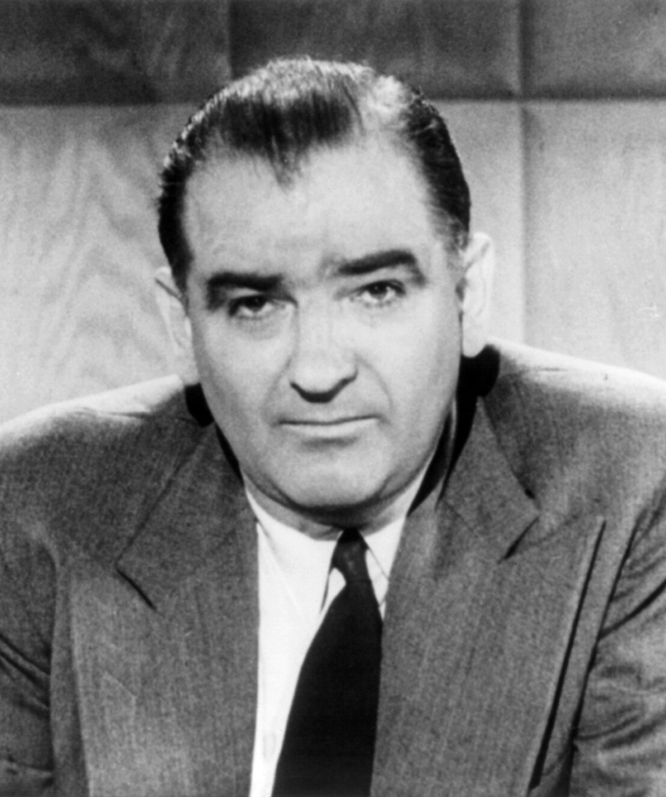
McCarthyism
Definition
Senator Joseph McCarthy began publically accusing people of being a communist without strong evidence.
Effect
Culture of Fear. No one wanted to be labeled as communist.

Slide 14
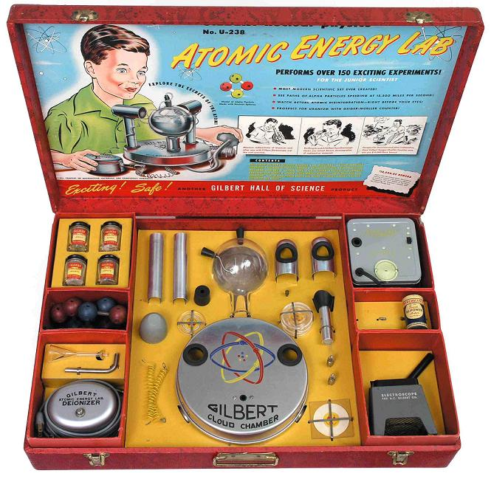
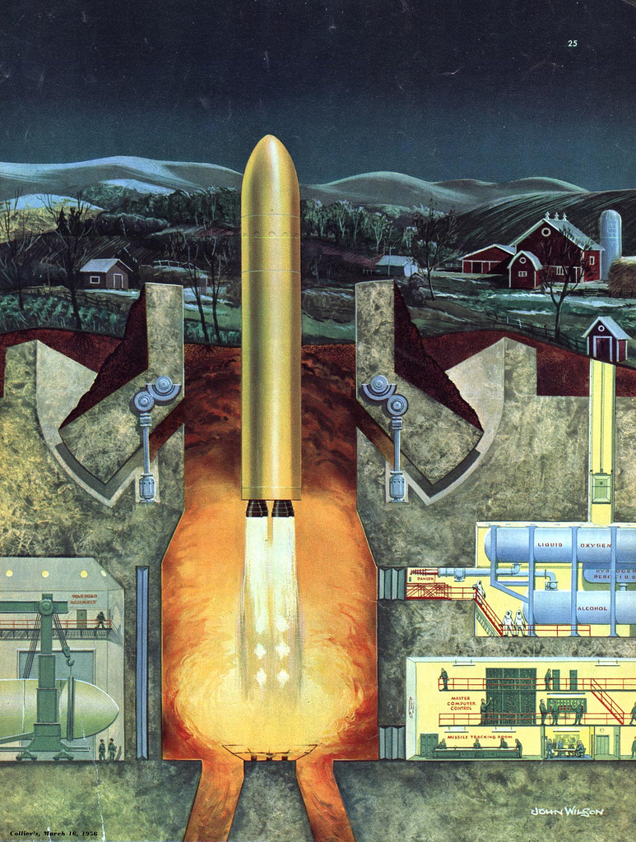
Atomic Age
Definition
Americans had high level of fear of an atomic bomb attack
Effect
Interest in nuclear energy and influenced pop culture

Slide 15
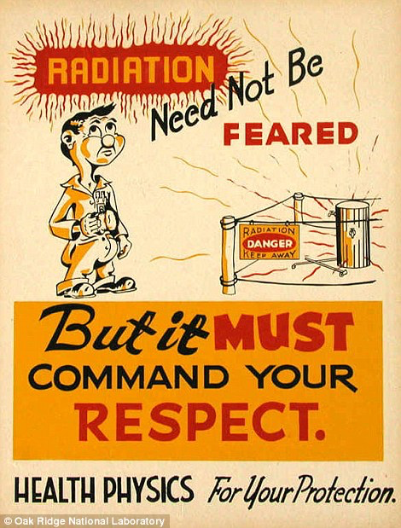
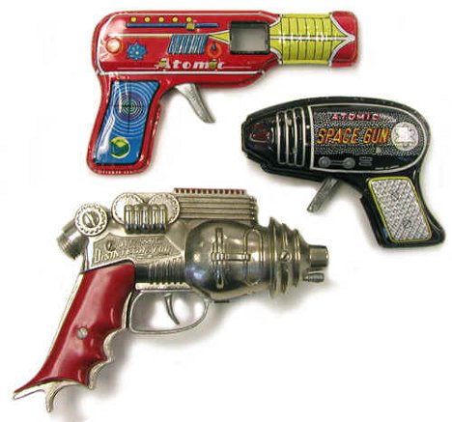
Atomic Age

Slide 16
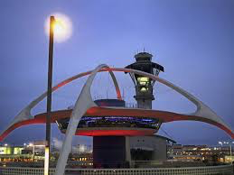
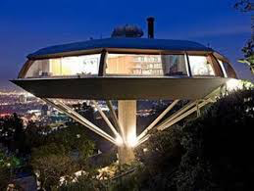
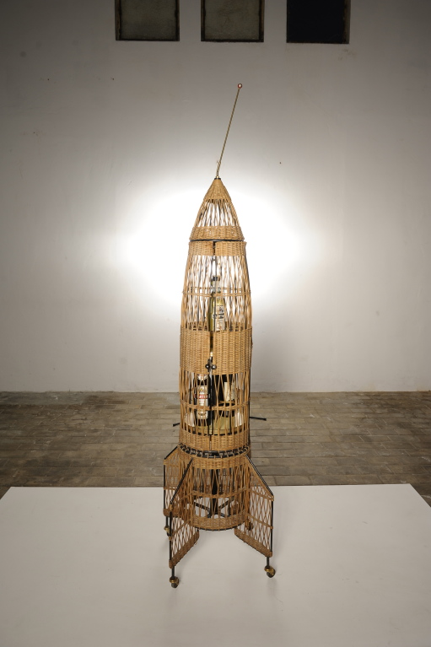
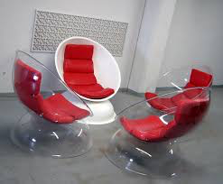
Atomic Age

Slide 17
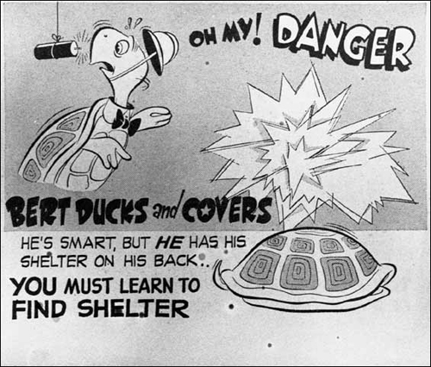
Federal Civil Defense Administration (FCDA) 1950
Definition: Created to help people prepare for a nuclear attack.
Effect:
Being prepared came with
Everyday life (Sirens, bomb
Shelters).
Operation Alert showed no amount of prep would be enough

Slide 18
National Defense Education Act 1958
Definition:
Increase in math and science education to keep up with the Soviets “space race” (sputnik launched the year before)
Effect:
Increased funding. Universities getting money had to sign a loyalty agreement to the US. Led to protests

