Slide 1
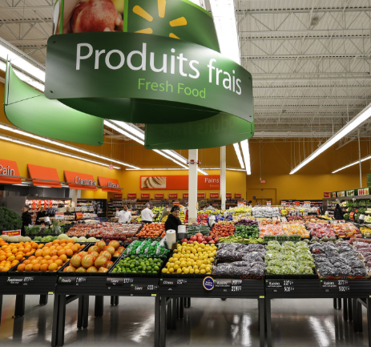
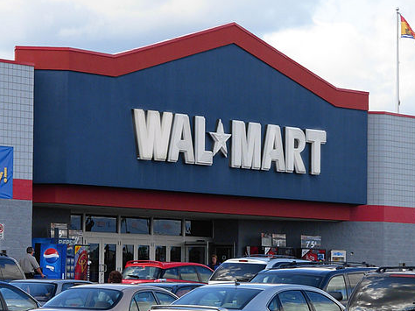
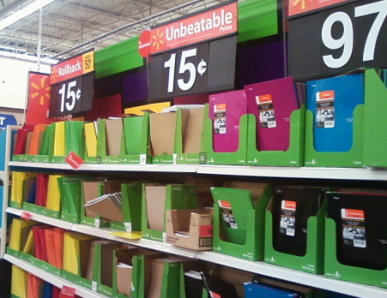
Do Now
Imagine that you are walking into Walmart. List 3 items that you could purchase and the departments that you would find them in.
Department Examples: Grocery, Electronics, Hardware, Clothing, Auto, Recreation, Furniture, Office, Toy

Slide 2
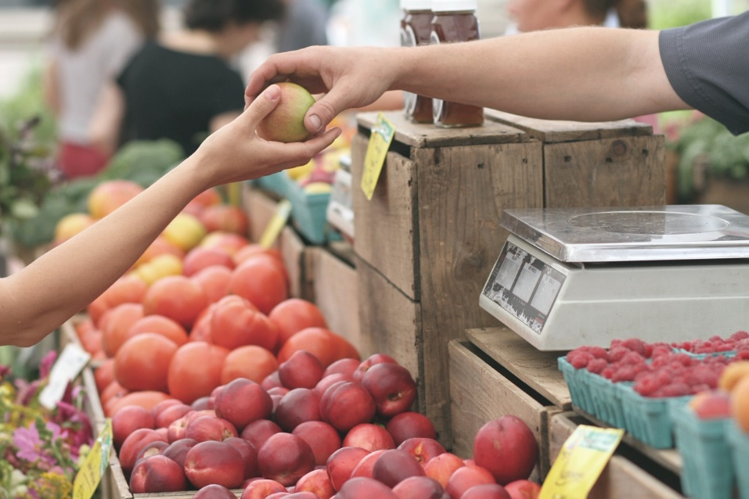
The Free Market
Market – buyers and sellers meet to exchange goods and services
Market Economy – economic decisions are made by consumers and businesses based on buying and selling of goods and services
All resources are privately owned
The government has a very limited role

Slide 3
Free Markets Video - Learn Liberty
https://www.youtube.com/watch?v=W-qGYlRtCcM&index=32&list=PL38BE680A76F35539

Slide 4
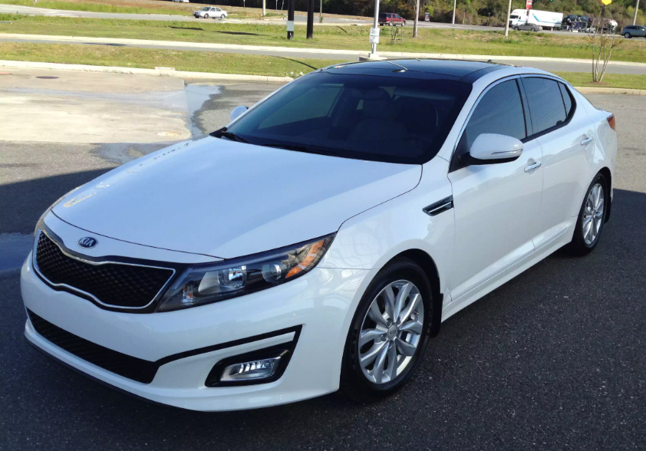
Voluntary Exchange
Voluntary Exchange – is the act of buyers and sellers willingly and freely engaging in market transaction where both parties benefit.
Examples:
When I buy gasoline, I get energy for my car, the firm gets my money

Slide 5
Candy Trade
Provide each person in the room with a random candy. I generally like to have at least 6 different types of candy.
copy the table on the following slide.
Rate your candy before trade 0-10.
Then conduct three rounds of trade.
Round 1: closed economy. you may only trade with a small group (ex. 4 trade partners based on proximity)
Round 2: open economy. You may trade with anyone on their side of the room
Round 3: completely free trade. The students may trade with anyone in the entire class.
Then, re-rate their candy to see how they ended up better off.
Potential discussion questions:
Who made a trade?
What was your candy initially; what did you trade it for?
What was your initial rating; what was your new rating?
How did you end up better off than when you started?
What are some real life examples of trade and voluntary exchange?

Slide 6
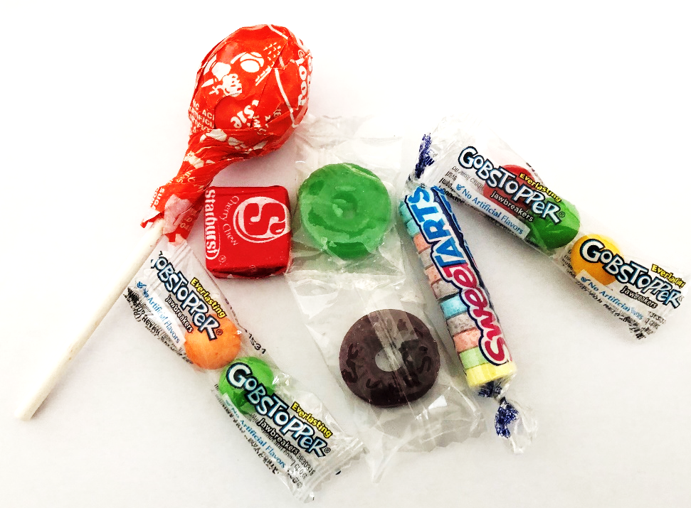
Voluntary Exchange Candy Trade
Candy | Rating before trade | New Candy | Rating after trade

Slide 7
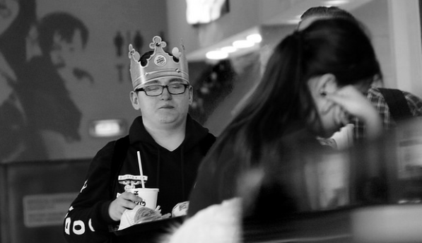
Role of the Consumer
“Ruler” of the market
Consumer Sovereignty – purchases signal what to produce
Dollar Vote = Consumers vote with their pocket book, vote for products

Slide 8
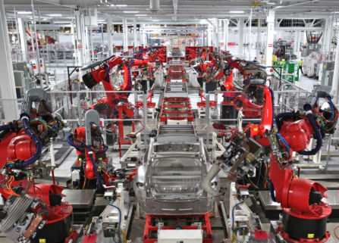
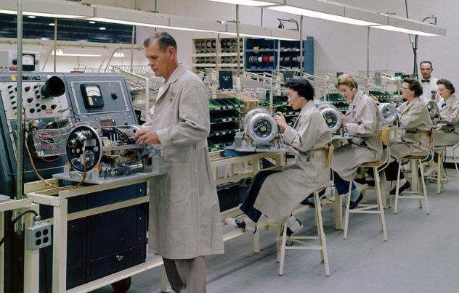
Specialization
Specialization – the separation of tasks; people focus on a specific purpose/task
Division of Labor – Workers perform fewer tasks in order to operate more efficiently

Slide 9
Specialization Examples in Education
*Specific department teach specific subjects*
History
Spanish

Slide 10
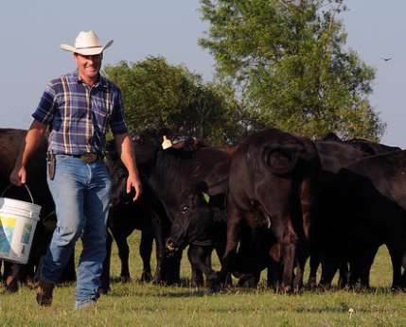
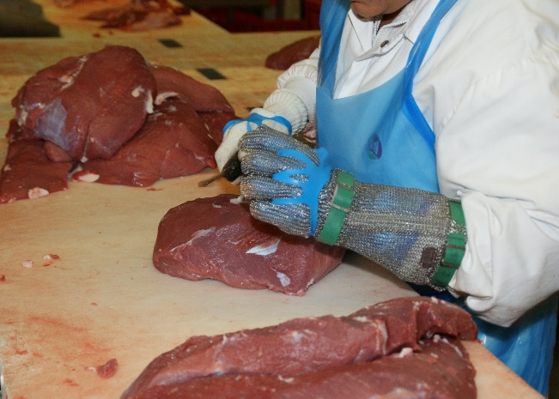
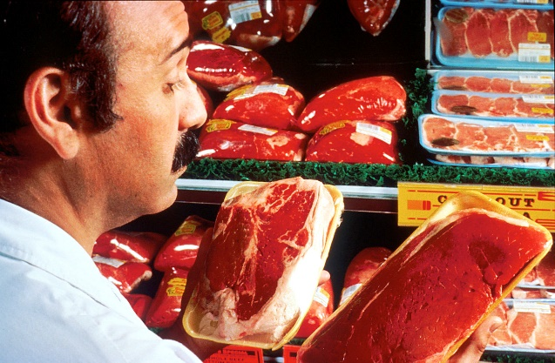
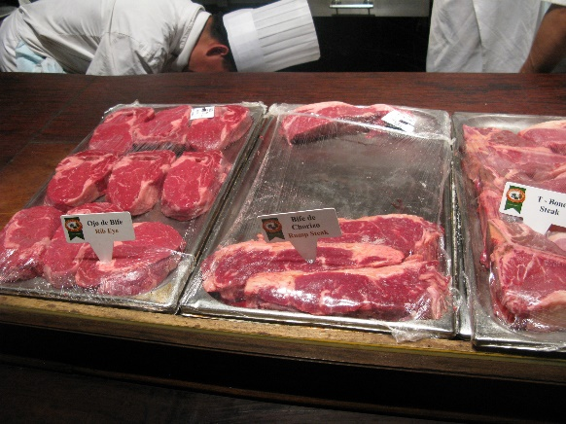
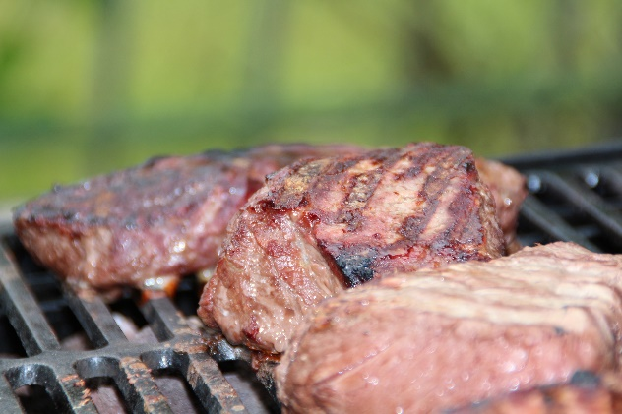
Specialization in the Meat Market - Everyone has a Role
Rancher
Slaughter House
Meat Cutter
Grocery Store Worker
Final Good (Output)
Consumer Good

