Slide 1
CounterCulture vs. Mainstream America
TCI Ch. 49

Slide 2
Objective
Discuss: How did the Counter Culture and Mainstream America Clash in the 1960s. What was the counter culture’s impact on America?
Debate on Tuesday (Hippies vs. Normies)
Quiz on Thursday as well

Slide 3
Agenda
Do Now
Lecture
Counter Culture vs. Mainstream Scavenger Hunt
#20time

Slide 4
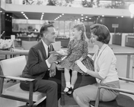
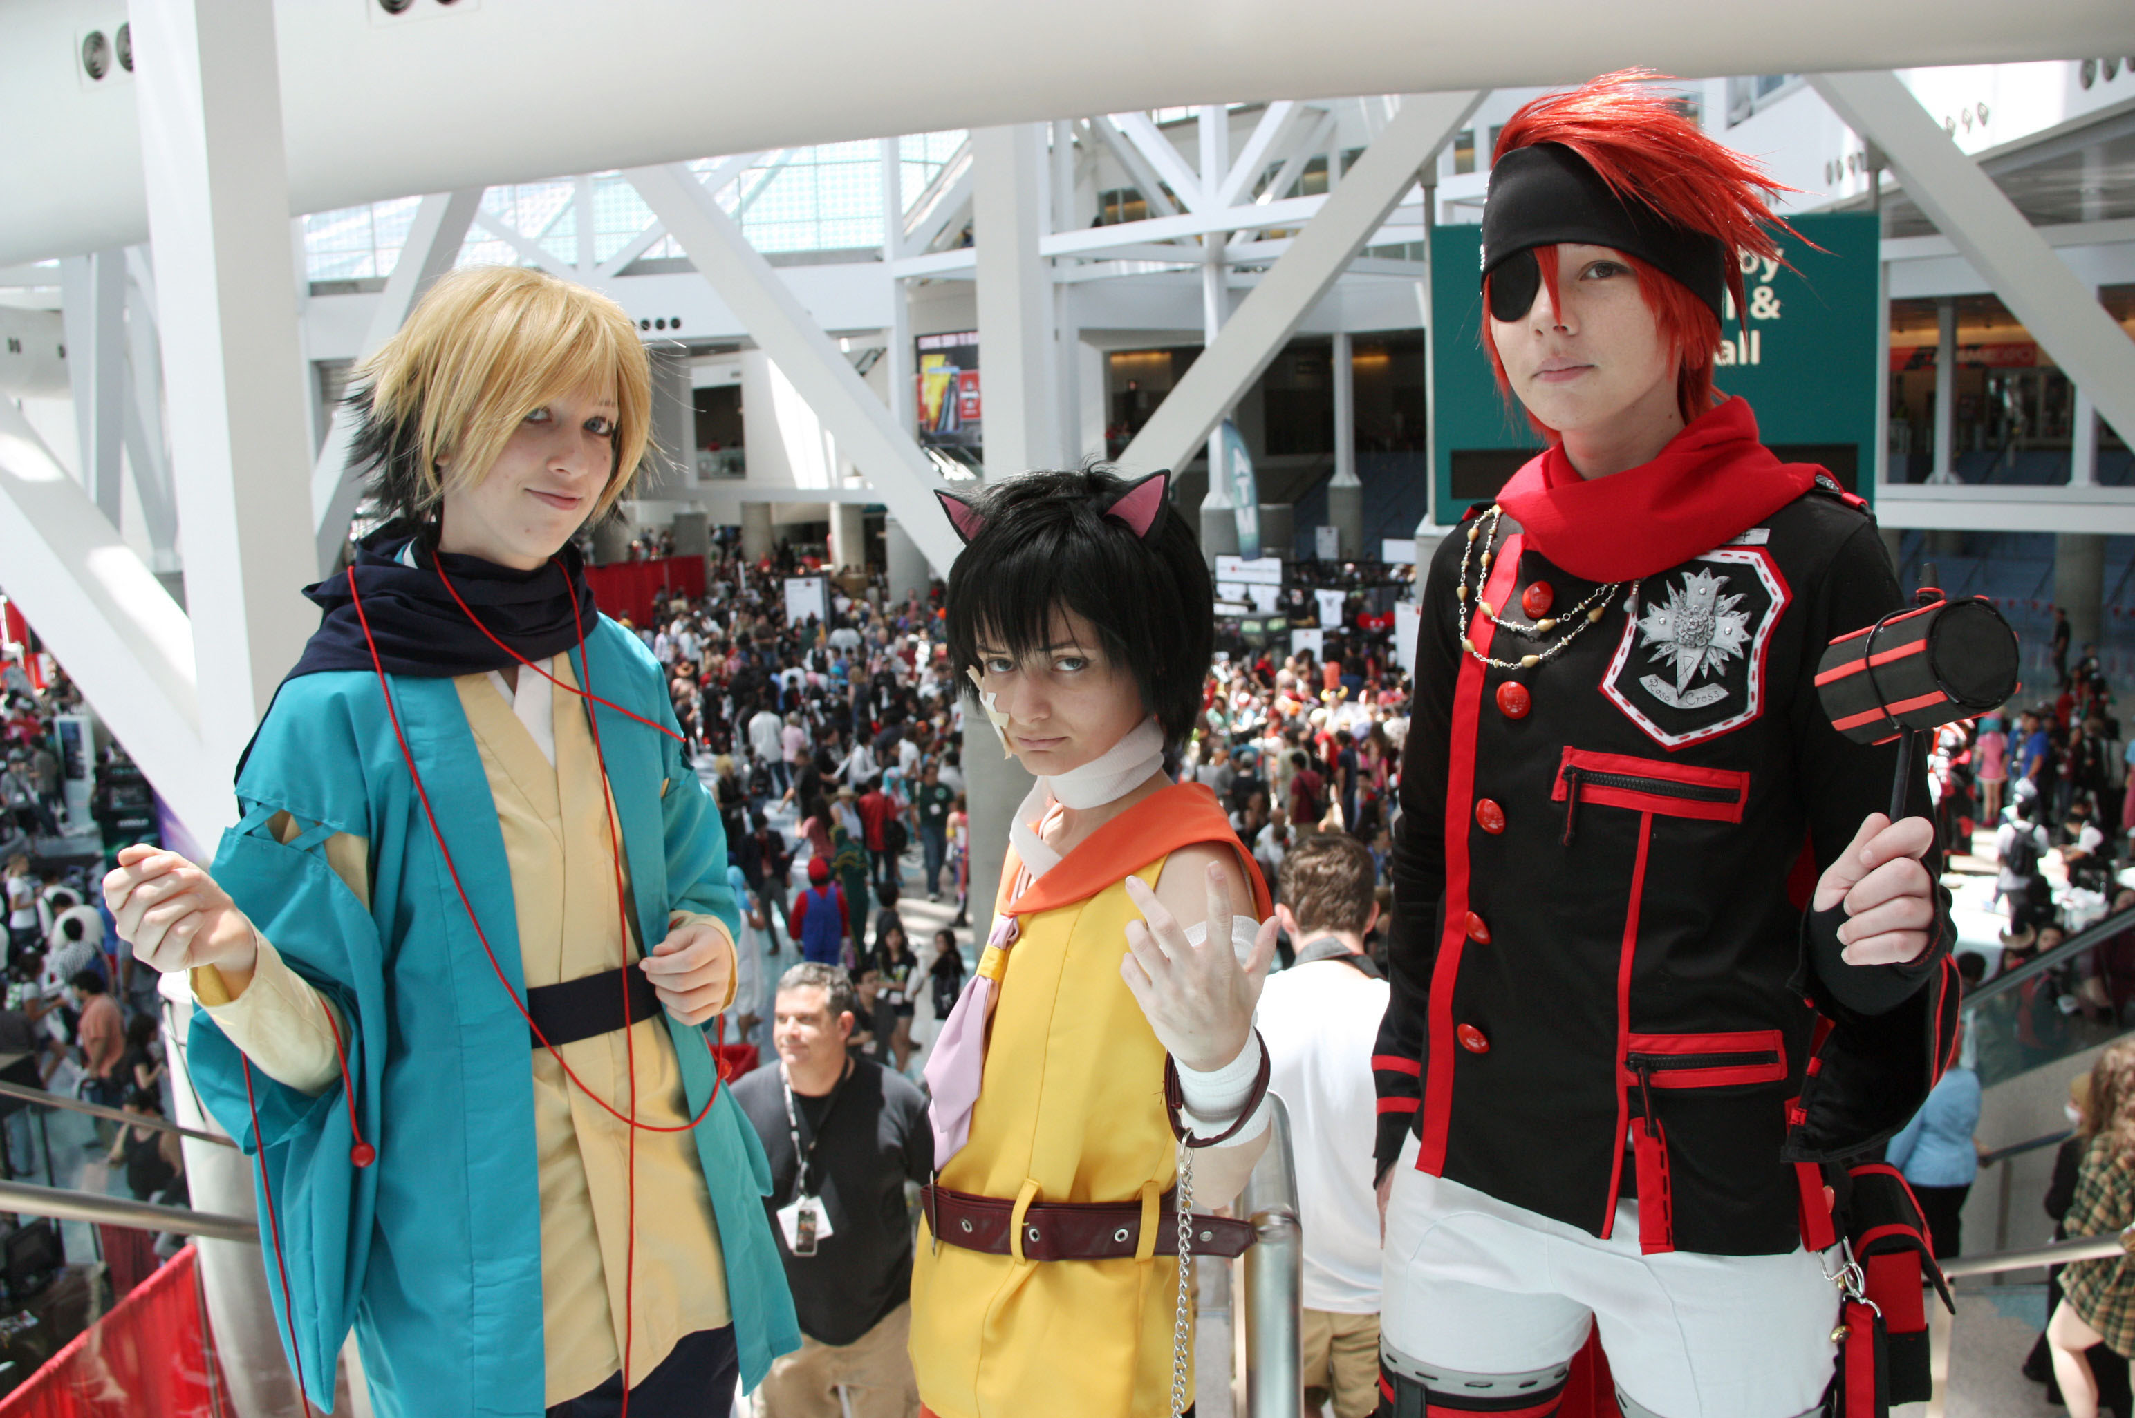
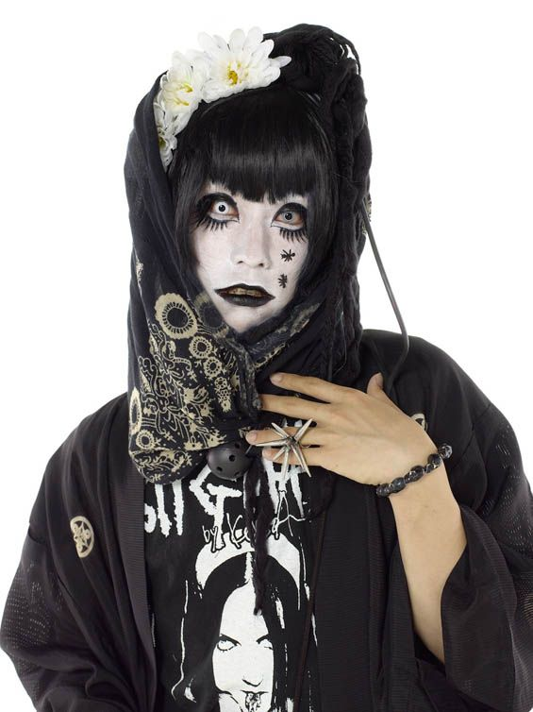
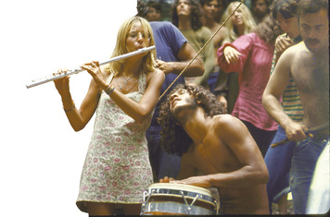
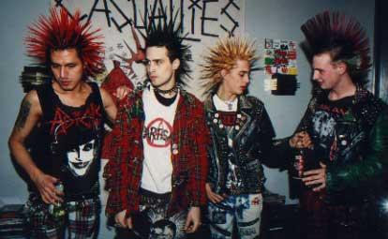
Counter Culture
Definition: A group in society who’s ideas are different from what is mainstream (Normal)
Notes:
Which picture doesn’t belong?

Slide 5
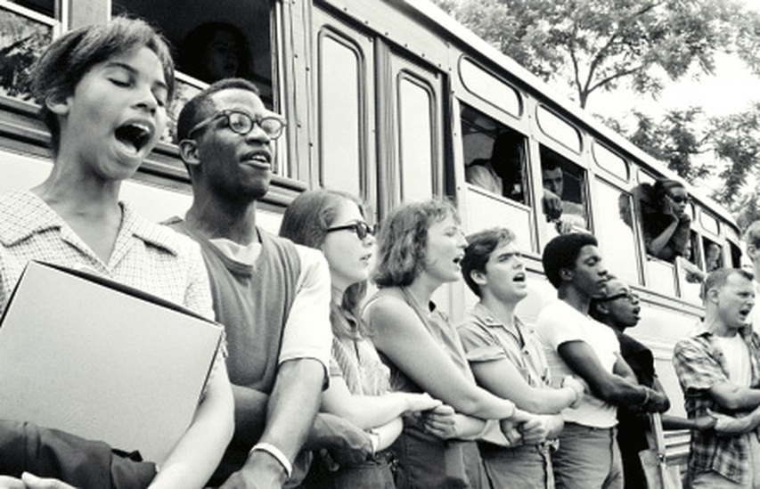
Origins: the New Left
1. They were inspired by the Civil Rights Movement.

Slide 6
Origins: the New Left
2. The students for a democratic society (SDS) dedicated itself to creating an equal and fair society for all.

Slide 7
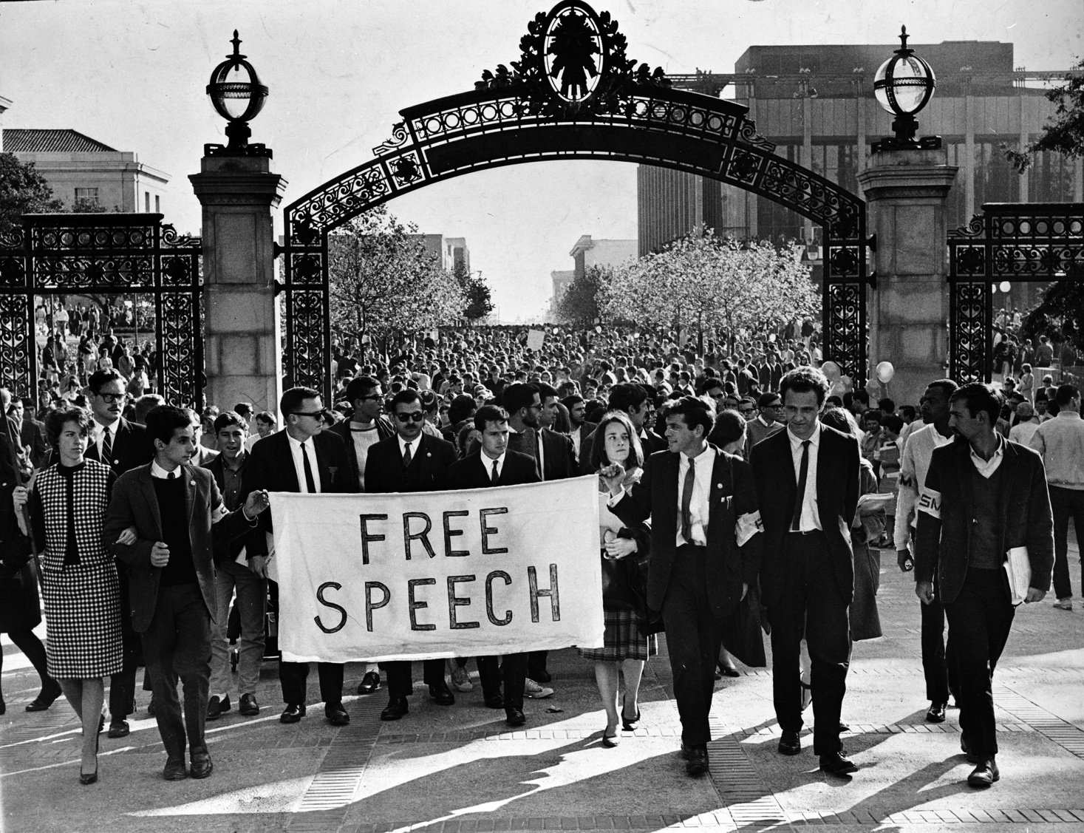
Origins: the New Left
3. The Free Speech Movement, started at UC Berkeley, focused on free expression. This led to a lot of protests at colleges by students demanding free speech.

Slide 8
Characteristics of the Counterculture
Hippies rebelled against social expectations by dropping out of school and avoiding traditional jobs.
Notes:
What were the new left politics?

Slide 9
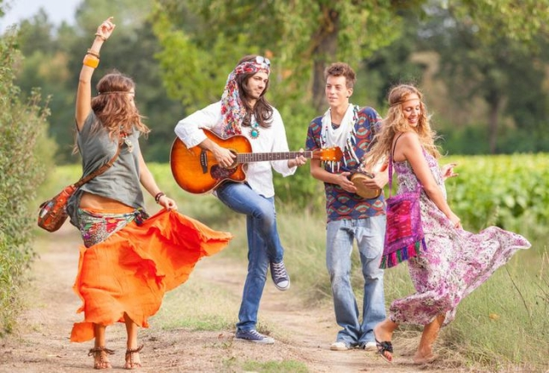
Characteristics of the Counterculture
Many grew their hair long, dressed in colorful clothes and shunned doing things like shaving and wearing makeup.
Notes:
What were the new left politics?

Slide 10
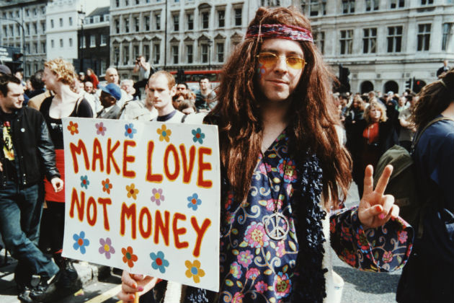
Characteristics of the Counterculture
They distrusted the establishment & believed love was more important than money.
Notes:
What were the new left politics?

Slide 11
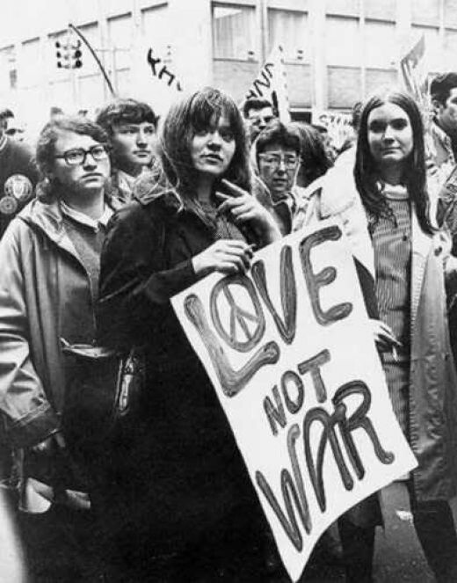
Characteristics of the Counterculture
They tried to combine their lifestyle with the politics of the New Left politics of peace and ending the Vietnam War.
Notes:
What were the new left politics?

Slide 12
Write one sentence below on why this symbol, a peace sign, represents the counterculture.

Slide 13
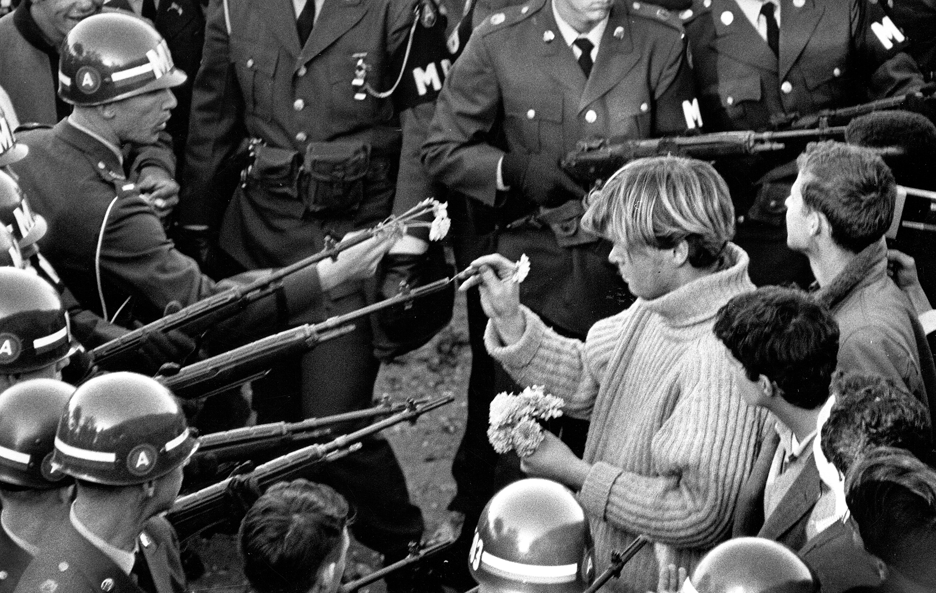
Characteristics of Mainstream America
Those who lived through the Great Depression and World War II saw hippies as spoiled and disrespectful.

Slide 14
Characteristics of Mainstream America
They resented the counterculture’s focus on hedonism (seeking pleasure).

Slide 15
Characteristics of Mainstream America
They represented not only adults but also the majority of young people in America.

Slide 16
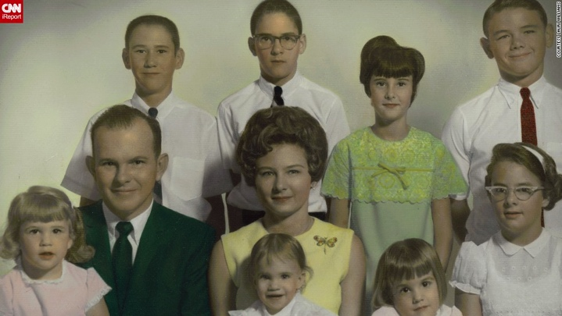
Characteristics of Mainstream America
Valued hard work, family, and respect for the country.

Slide 17
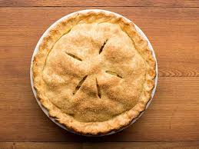
Write one sentence below on why this symbol, Apple Pie, represents the mainstream America.

Slide 18
WALK AROUND!
Find somewhere new to sit and meet someone new!

Slide 19
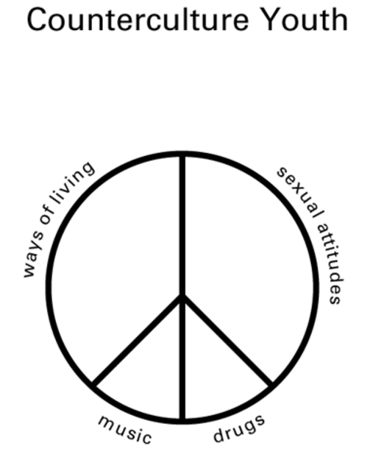
Read TCI Ch. 49 Section 3 and Find 2 characteristics of the Counter Culture for each category.

Slide 20
WALK AROUND!
Find somewhere new to sit and meet someone new!

Slide 21
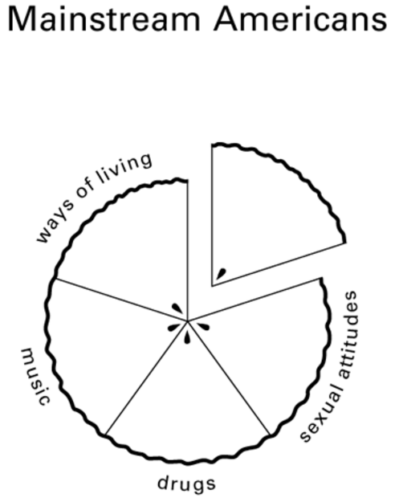
Read TCI Ch. 49 Section 3 and Find 2 characteristics of the Mainstream America for each category.

