Slide 1
Criticism of the New Deal

Slide 2
Key Vocabulary
Right Wing = Conservative
Left Wing = Liberal

Slide 3
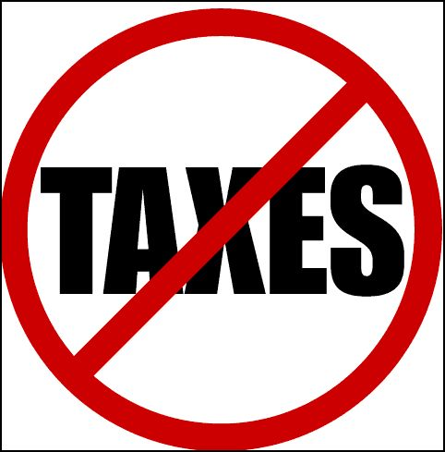
Conservatives against the New Deal
The Right Wing
Believed the New Deal gives the government too much power. (Higher Taxes, More Regulations on business)
Believed it was leading towards Socialism
Believed it was trying to take away Private business ownership
American Liberty League formed to oppose the New Deal

Slide 4
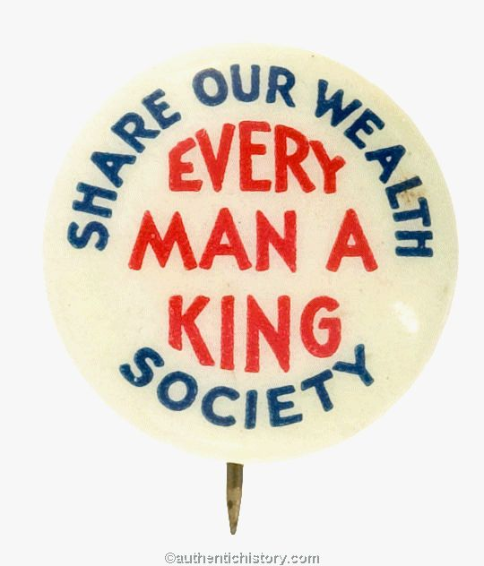
Liberals against the New Deal
Some on the left wing thought the New Deal didn’t do enough to help the poor
Huey Long & “Share our Wealth”
wanted everyone to have guaranteed job and income.
Charles Coughlin
Roosevelt not doing enough to help poor (”Outhooverd Hoover”
Socialists
New Deal is a “Rose in a Pile of Weeds”

Slide 5
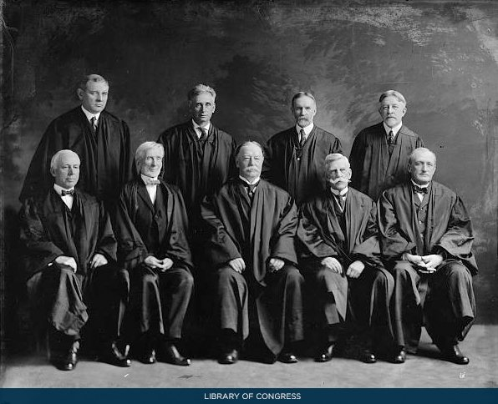
Challenges to the New Deal in the Court System
Supreme Court Declares some Programs (AAA) (NIRA) unconstitutional.
Government can’t control prices. Only businesses can set prices.
“Courtpacking:” FDR attempted to add judges that were liberal/left wing to the supreme court in order to support the New Deal
Failed to do this

Slide 6
Is the New Deal constitutional?
1937: Social Security and Wagner Act were declared constitutional
Its constitutional for congress to provide a safety net. Forming a Union is free speech
Old thinking: Freedom = Make Unlimited Money/laissez-Faire
New Thinking: Freedom = Protection from poverty

Slide 7
Challenges to the New Deal Primary Sources
Read each primary source (Comic or Text) and answer the following prompts.
Is the author a liberal (left wing) or conservative (right wing)
What evidence proves your

