Slide 1
US gets involved in Vietnam
T

Slide 2
Add to your Notebook
US gets involved in Vietnam (TCI Ch 50)

Slide 3
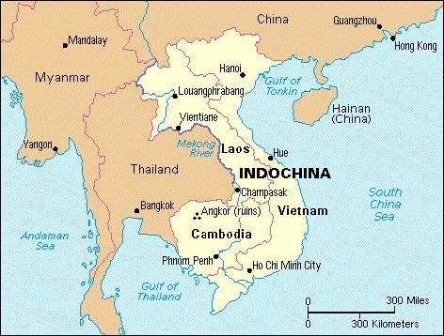
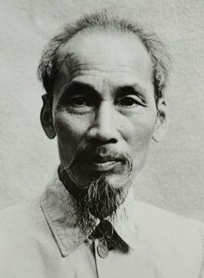
1945 Vietnam Declares Independence from France
Ho Chi Minh & “Vietminh”
French Indochina

Slide 4
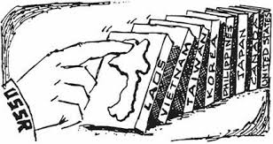
1950-1954 US Supports France in 1st French Indochina War
“DOMINO THEORY”

Slide 5
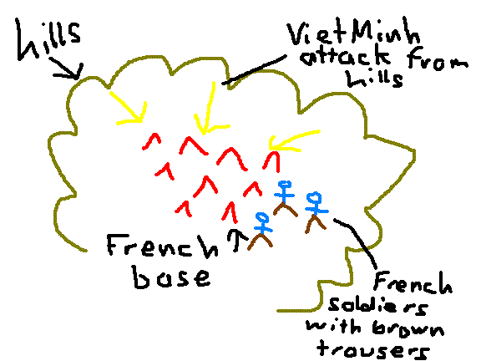
1954 Battle of Dien Bien Phu
French leave Indochina (Vietnam)

Slide 6
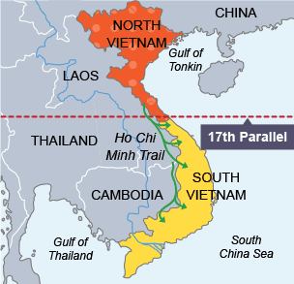
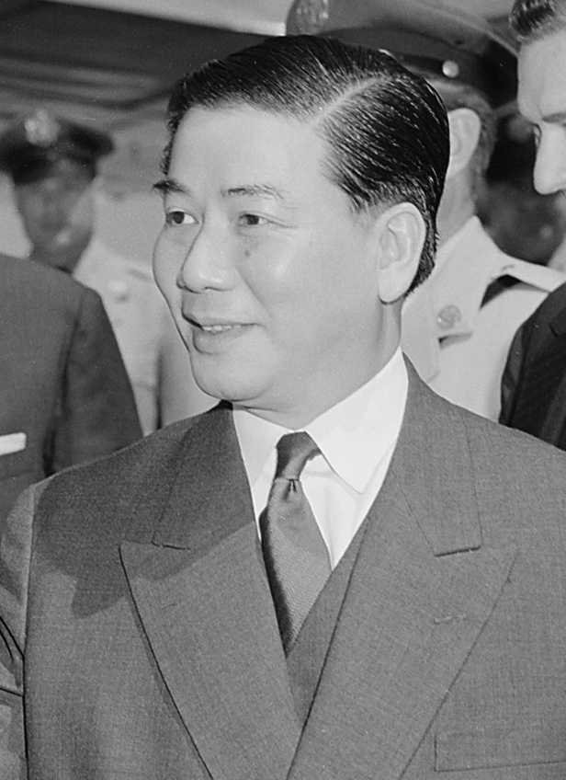
1954 Geneva Accords
Ho Chi Minh (N. Vietnam)
Ngo Dinh Diem (S. Vietnam)
(NO-DIN-DE-YEM

Slide 7
Turn and Talk
What is this similar to?
Notes:
Korean War

Slide 8
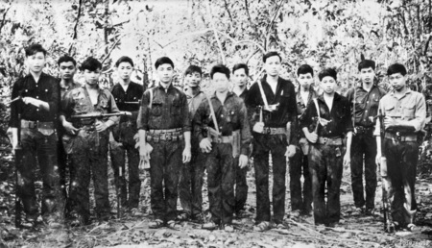
1960 Vietcong are formed
Rebels against S. Vietnam with $$ from N. Vietnam

Slide 9
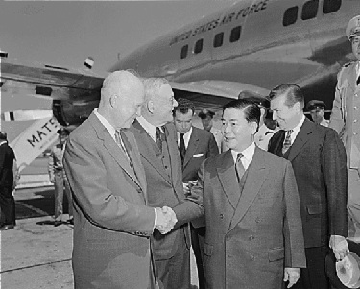
Ngo Dinh Diem is backed by the US government
Diem shaking President Eisenhower’s hand

Slide 10
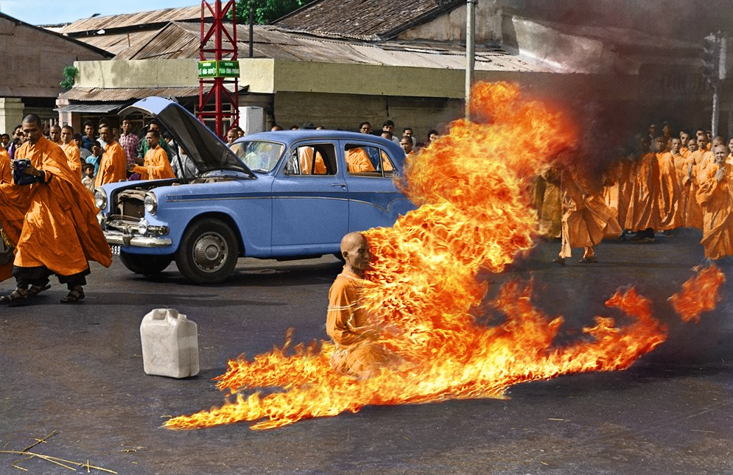
1963 Assassination of Ngo Dinh Diem
Buddhist Monk sets self on fire protesting Diem’s treatment of them . Diem looses control of nation

Slide 11
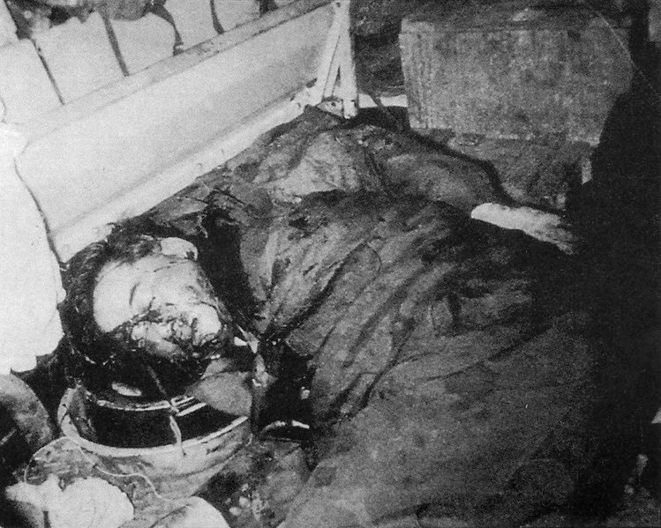
1963 Assassination of Ngo Dinh Diem
Diem was arrested and assassinated by his generals

Slide 12
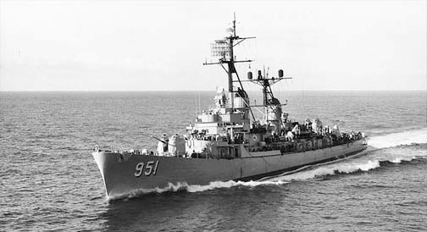
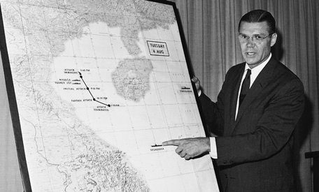
1964 Gulf of Tonkin Incident
USS Maddox
“Take all measures necessary”

Slide 13
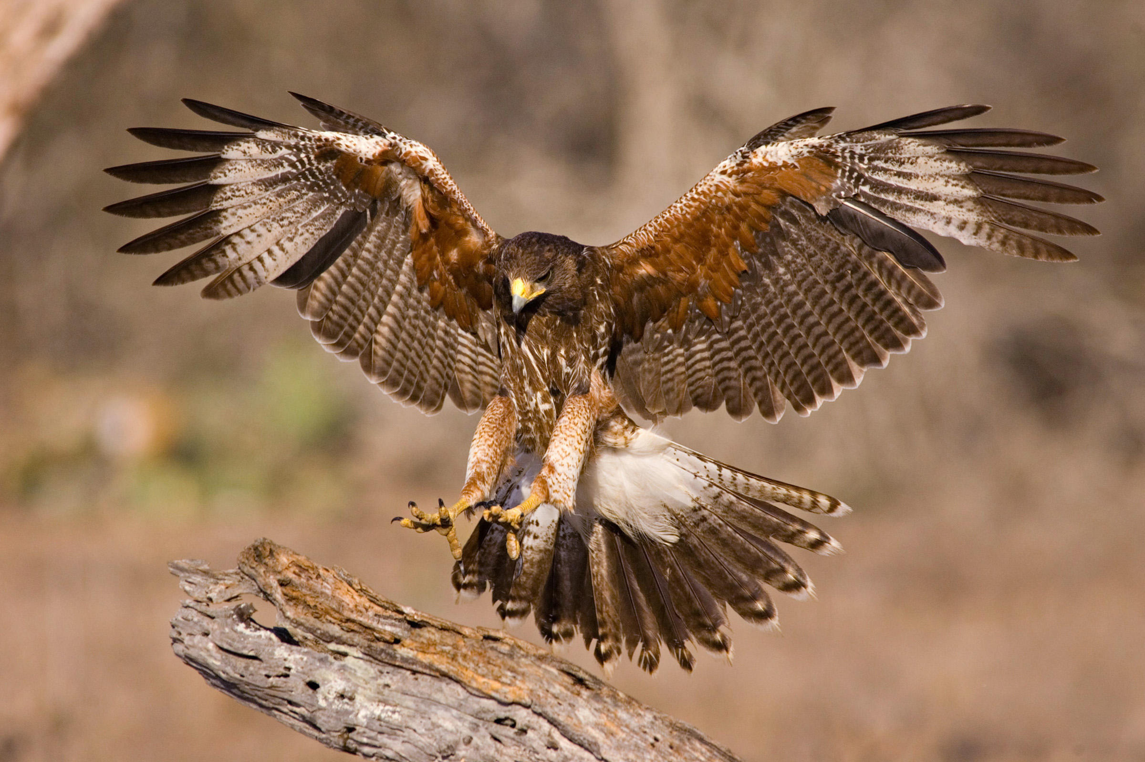
Hawks (pro war) or Doves (pro peace)
Read each primary source and label each one as a Hawk or a Dove.

Slide 14
Should President Johnson increase troops in Vietnam?
You will be assigned as either a
Hawk (yes, increase troops)
Doves (no, decrease troops)
Come up with one argument on your side from your notes and also TCI Ch. 51 and the primary sources.

Slide 15
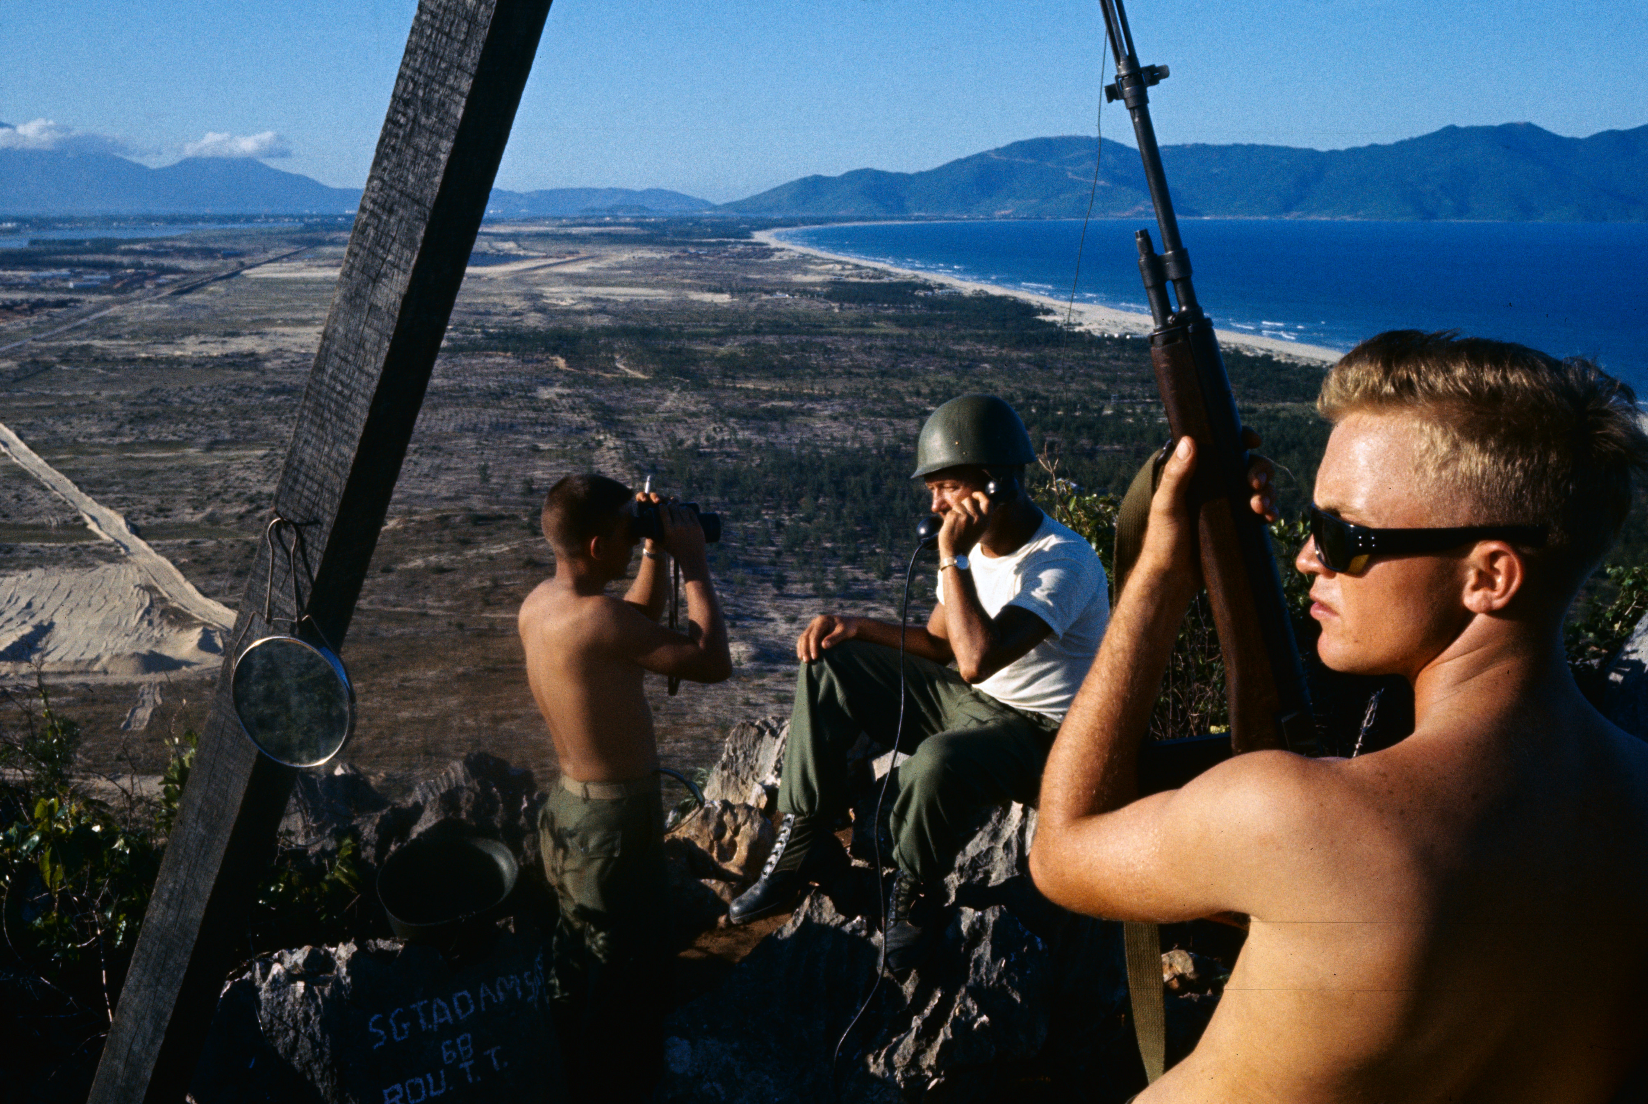
1965 First US troops land
Da Nang, Vietnam (first

Slide 16
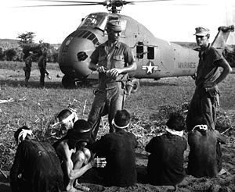
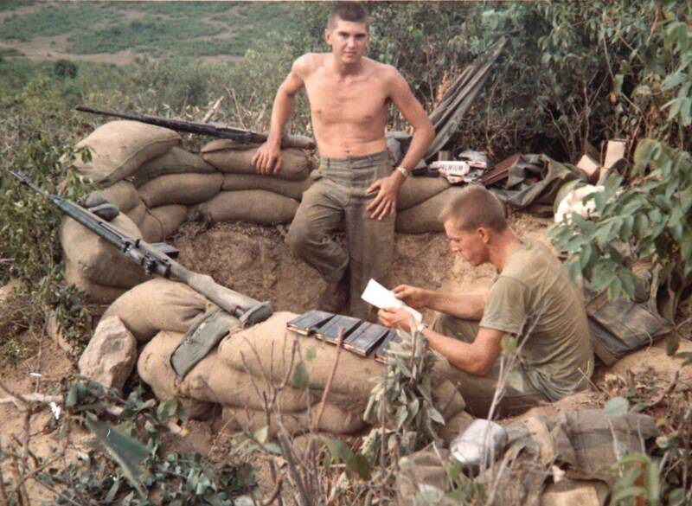
1965 Operation Starlight

