Slide 1
Illinois
3 Facts from the Reading:
Quotation from the Primary Source:
3 Facts from the Reading:
Ohio
Quotation from the Primary Source:

Slide 2
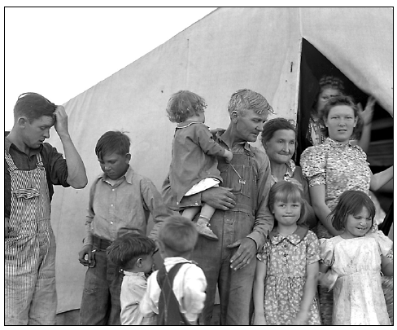
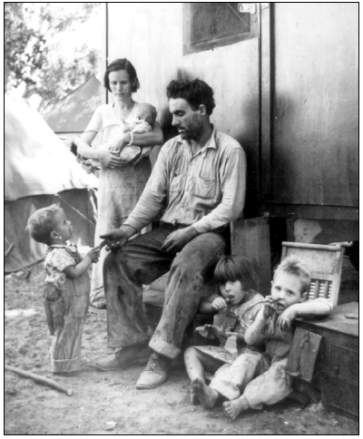
New Jersey
3 Facts from the Reading:
Quotation from the Primary Source:
3 Facts from the Reading:
Texas
Quotation from the Primary Source:

Slide 3
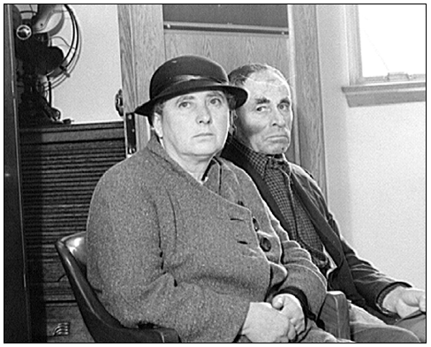
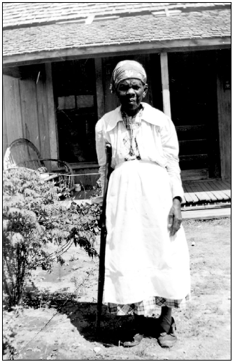
Oregon
3 Facts from the Reading:
Quotation from the Primary Source:
3 Facts from the Reading:
Georgia
Quotation from the Primary Source:

Slide 4
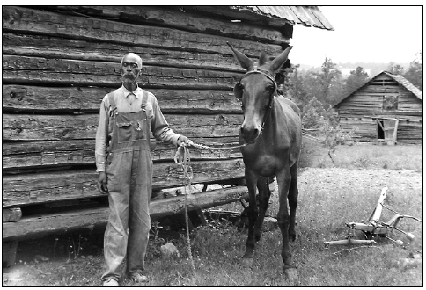
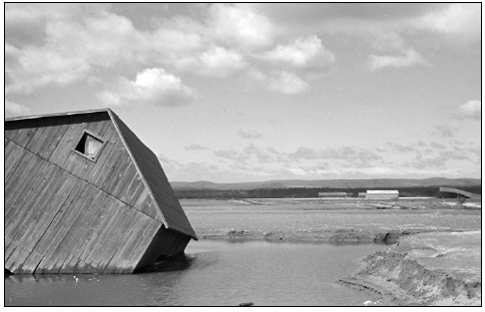
North Dakota
3 Facts from the Reading:
Quotation from the Primary Source:
3 Facts from the Reading:
Pennsylvania
Quotation from the Primary Source:

