Slide 1
Human toll of the Great Depression
Ch. 32 TCI

Slide 2
Add to your notebook
Life during the Great Depression 3

Slide 3
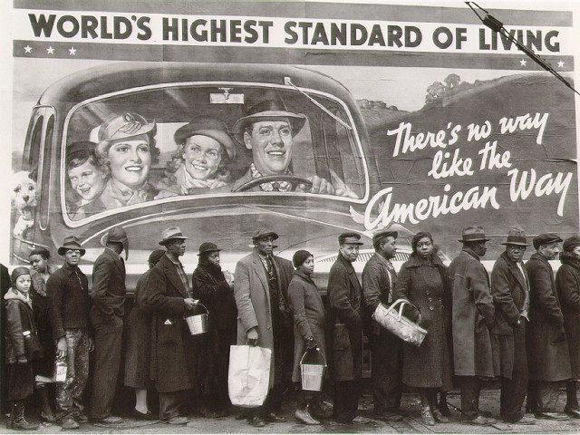
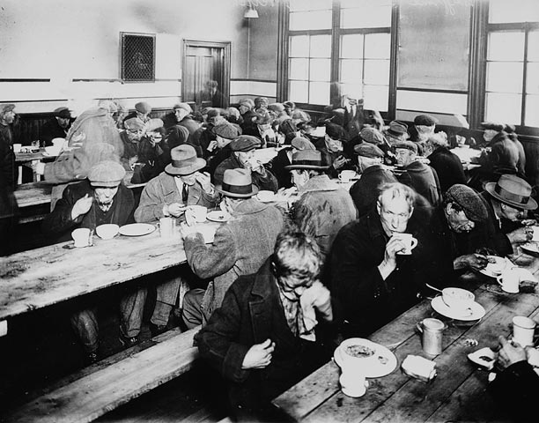
Soup Kitchen & Breadline
A place where the homeless can get food.

Slide 4
Bread Line

Slide 5
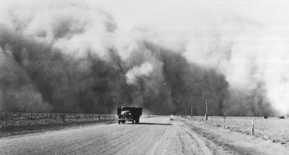
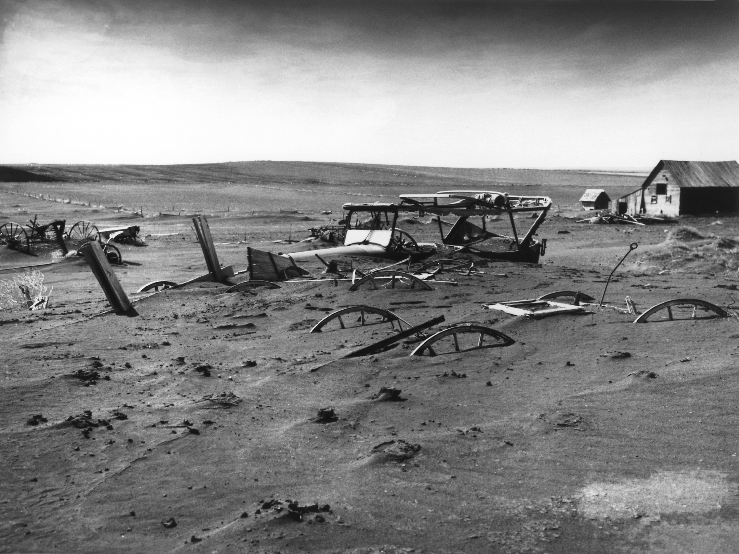
Dust Bowl
Many farmers moved to Southern Planes to own a Farm
Farming cut up the soil + drought + massive dust storms (black blizzards) = destruction of farms and lives.

Slide 6
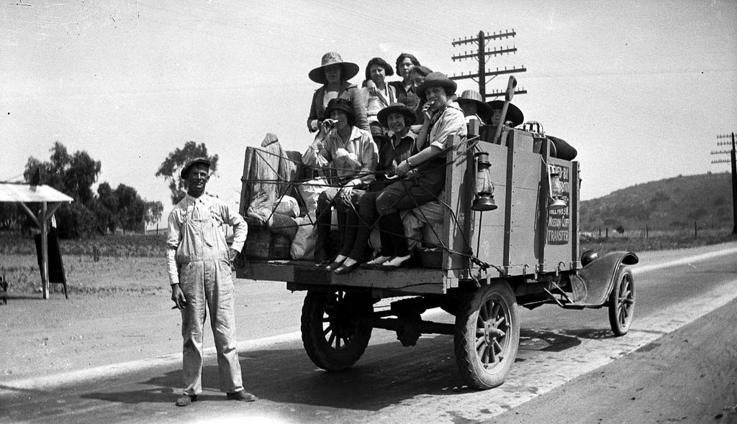
Dust Bowl
Many moved to Cali, called “Okies.”

Slide 7
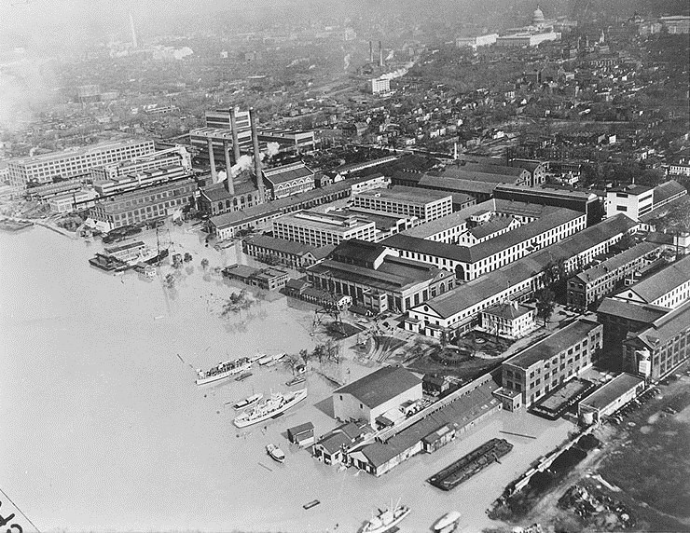
Great Flood of 1936
Floods in the Northeast, Many buildings destroyed.

Slide 8
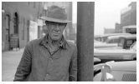
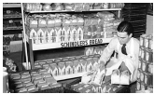
Illinois
3 Facts from the Reading:
Quotation from the Primary Source:
3 Facts from the Reading:
Ohio
Quotation from the Primary Source:

Slide 9
Great Depression Investigation
Read the section of the textbook for each station (Its highlighted by the photo)
Record 3 important facts from the section.
Quote from the Primary Source that describes how tried to live during this time or how did they survive
DON’T JUST TAKE FROM THE FIRST LINE

Slide 10
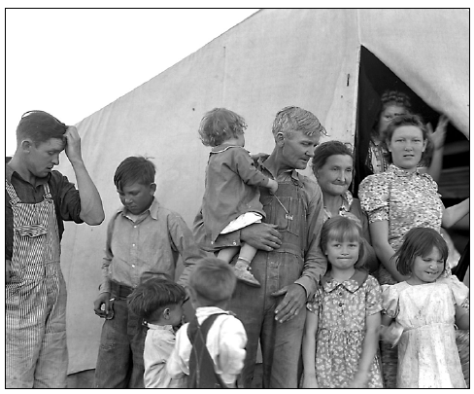
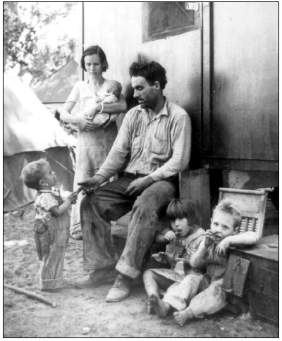
New Jersey
3 Facts from the Reading:
Quotation from the Primary Source:
3 Facts from the Reading:
Texas
Quotation from the Primary Source:

Slide 11
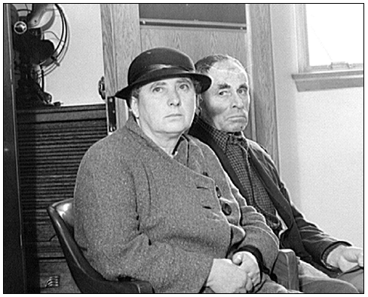
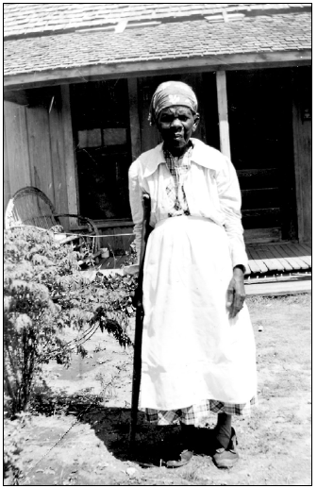
Oregon
3 Facts from the Reading:
Quotation from the Primary Source:
3 Facts from the Reading:
Georgia
Quotation from the Primary Source:

Slide 12
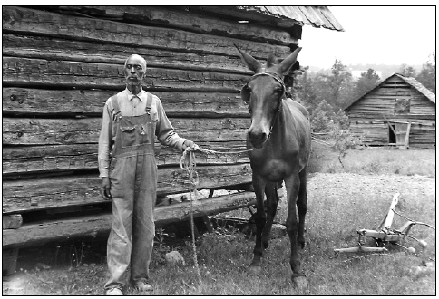
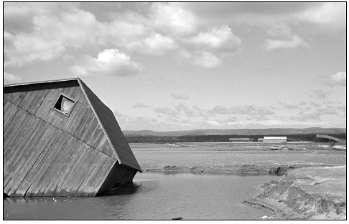
North Dakota
3 Facts from the Reading:
Quotation from the Primary Source:
3 Facts from the Reading:
Pennsylvania
Quotation from the Primary Source:

