Slide 1
Essential Question
Why did the Soviet Union and the United States become enemies?

Slide 2
World War 2 Alliances end
Soviet Union
Stalin’s decisions were driven by security concerns. Stalin wanted a buffer zone of friendly communist states to protect the Soviet Union. Stalin claimed Eastern Europe as a Soviet sphere of in influence.

Slide 3
World War 2 Alliances end
United States
• Truman wanted to allow Eastern European nations to determine their own form of government. Believed they would choose democracy

Slide 4
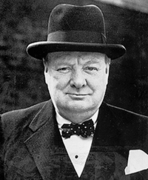
PRIMARY SOURCE TIME!
From Stettin in the Baltic to Trieste in the Adriatic an iron curtain has descended across the Continent. Behind that line lie all the capitals of the ancient states of Central and Eastern Europe…. I do not believe that Soviet Russia desires war. What they desire is the fruits of war and the indefinite expansion of their power and doctrines.
-Winston Churchill “Iron Curtain Speech

Slide 5
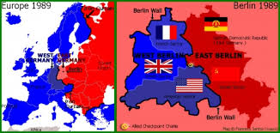
“Iron Curtain

Slide 6
Differing Ideologies
Soviet Union
The Soviets believed in communism, which viewed capitalism as an unjust system.
Communism revolves around single-party rule of politics and government control of the economy.
The state owns most businesses and decides what will be produced.

Slide 7
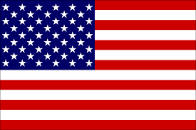
Differing Ideologies
United States
The American system was based on a belief in democratic government and capitalist economics.
In capitalism, individuals and private businesses make most economic decisions.
Most property, factories, and equipment are privately owned.

Slide 8
Adjusting to a post WW2 World
Challenge: In 1946, Stalin declared that peace was impossible as long as capitalism existed. The United States feared that the USSR planned to spread communism beyond Eastern Europe to other parts of the world. The possibility of a conflict between these two super- powers was frightening because of the invention of the atomic bomb.

Slide 9
Adjusting to a post WW2 World
Response: The United States proposed the Baruch Plan to the UN Atomic Energy Commission. The plan suggested a ban on future bomb making, but it allowed the United States to retain its small nuclear stockpile. The USSR strongly opposed the plan. The Soviets wondered why the United States should be allowed to keep its atomic bombs while denying the USSR the right to develop its own weapons.

Slide 10
PRIMARY SOURCE TIME
The very existence of the Greek state is today threatened by the terrorist activities of several thousand armed men, led by Communists, who defy the government's authority. . . . Greece must have assistance if it is to become a self-supporting and self-respecting democracy…... Should we fail to aid Greece and Turkey in this fateful hour, the effect will be far reaching to the West as well as to the East.
-Truman Doctrine

Slide 11
Confronting the Communist Threat
Challenge: The Soviet Union was setting up Soviet- controlled governments in Poland and other Eastern European countries. Churchill warned that Stalin was cutting off this region from the rest of Europe, calling the barrier the Iron Curtain. Because it seemed communism was spreading, the United States became concerned about the civil war in Greece. Communist rebels tried to take over the Greek government.

Slide 12
Confronting the Communist Threat
Response: Truman outlined a policy of containment in the Truman Doctrine in the hopes of stopping the spread of communism. The United States sent aid and military equipment to help the Greek government defeat the communist rebels. The Soviets viewed the United States and its allies as hostile powers committed to destroying communism and threatening Soviet security.

Slide 13
Rebuilding European Economies
Challenge: On both sides of the Iron Curtain, Europe was in terrible shape after the war. Governments and economies barely functioned. U.S. leaders feared that conditions in Europe would give rise to political and social unrest. Some Europeans began to look to communist ideology for answers to their problems.

Slide 14
Rebuilding European Economies
Response: The United States proposed the Marshall Plan for European recovery. Generous funding for rebuilding was offered to all European nations as long as the money was spent on U.S. goods. The Soviet Union saw the plan as an attempt to interfere in Soviet internal affairs. In 1949, the USSR created the Molotov Plan to aid economic recovery in Eastern Europe.

Slide 15
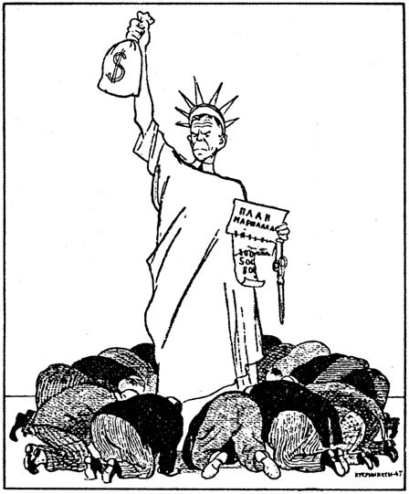
Marshall Plan

Slide 16
PRIMARY SOURCE TIME
The foreign policy of the United States, which reflects the imperialist tendencies of American monopolistic capital, is characterized in the postwar period by a striving for world supremacy. This is the real meaning of the many statements by President Truman and other representatives of American ruling circles; that the United States has the right to lead the world.
-Soviet Telegram by Ambassador Novikov

Slide 17
Exit Ticket
Why did the Soviet Union and the United States become enemies? Rank the top 3 in order and give your reasons why.
Marshall Plan
Molotov Plan
Truman Doctrine
Differening Ideologies (Capitalism vs. Communism)
Iron Curtain

