Slide 1
Ch. 52. Getting Out of Vietnam
PowerPoint Picture. Please see the Notes for detailed notes.

Slide 2
1. Vietnamization and “Peace with Honor”

Slide 3
2. Bombing of Cambodia and My Lai Massacre

Slide 4
3. Kent State University and Protest in Support of War

Slide 5
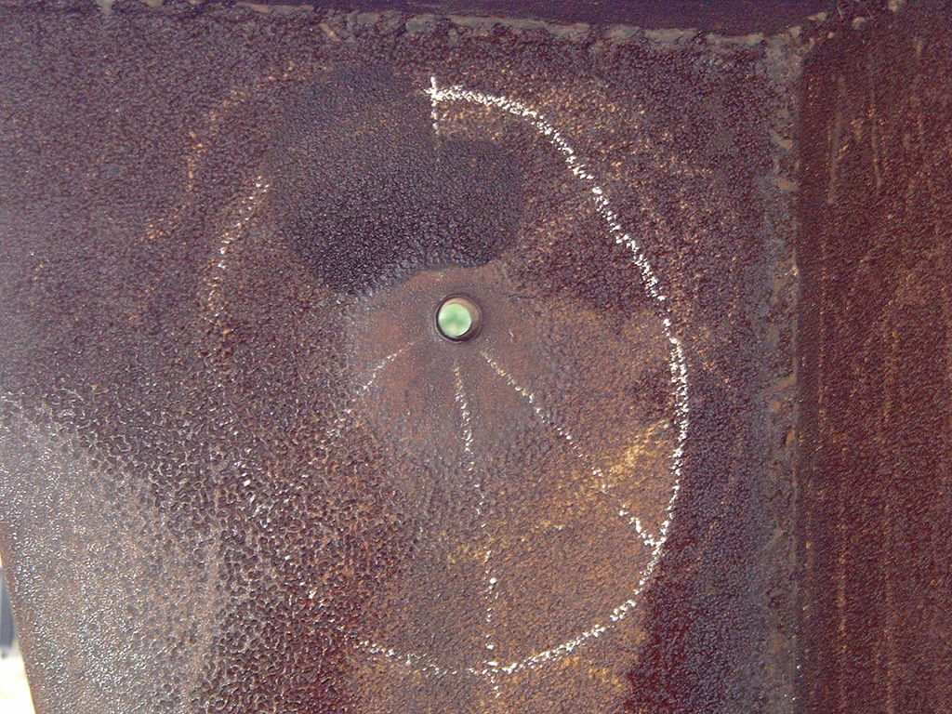
Crosby Stills Nash & Young “Ohio”

Slide 6
4. Pentagon Papers

Slide 7
5. War Powers Resolution
Gulf of Tonkin Resolution repealed.
President must get Congress approval for War after 100 days or else the troops must return home.

Slide 8
6. Paris Peace Accords

Slide 9
7. Returning Soldiers and POWs
Prisoners of War

Slide 10
9. N. Vietnam captures Saigon (1975)
US evacuates Saigon.
The “end of the war”

Slide 11
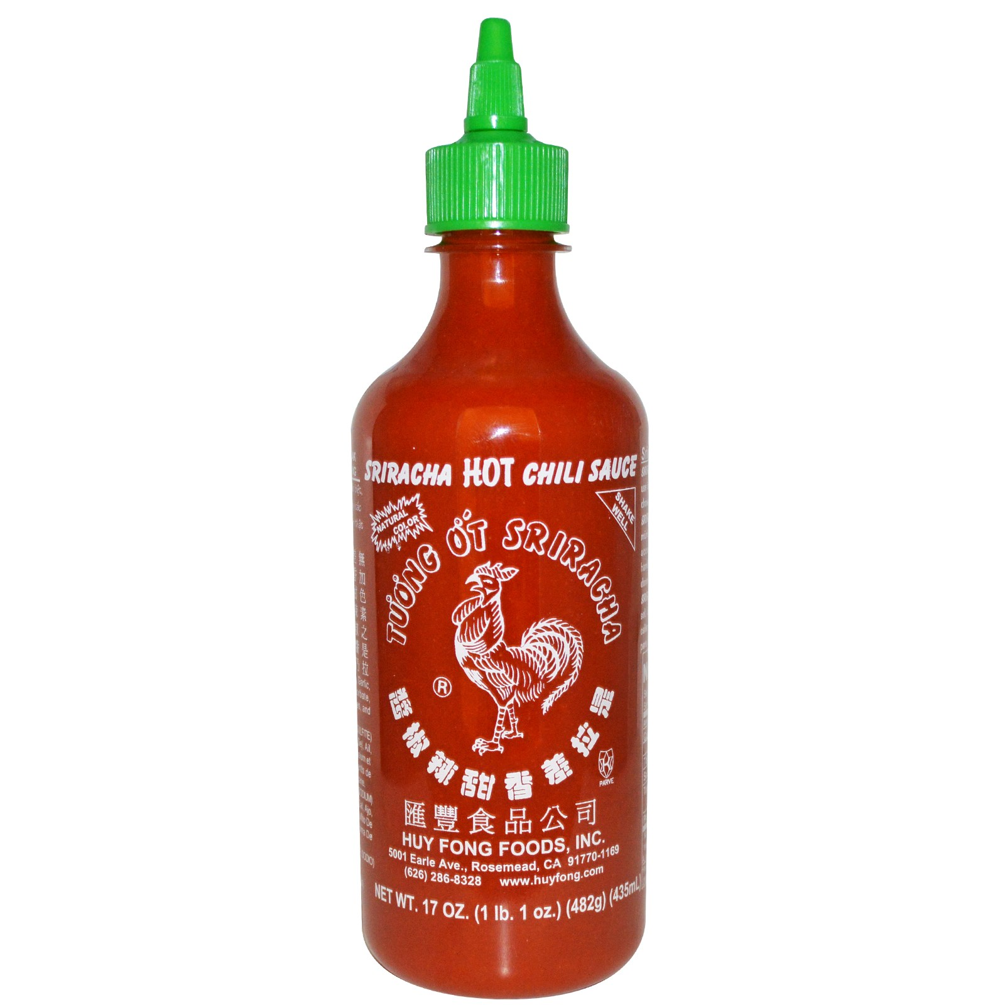
9. 1 million S. Vietnamese flee

Slide 12
9. Cambodia falls to communism
Pol Pot.
“Killing Fields”

Slide 13
10. Vietnam War Memorial

