Slide 1
Causes of the Great Depression
Chapter 30
teachtci

Slide 2
New Table of Contents Unit 5 Great Depression
Causes of the Great Depression (ch. 30) 1

Slide 3
Essential Question
What caused the Great Depression?

Slide 4
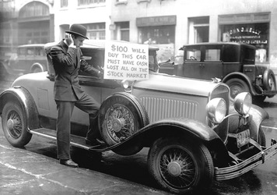
Black Tuesday (10/29/29)
The Stock Market Crashes.

Slide 5
Yee-Haw!
History
Many students selected the “Go for the Gold!” option with hopes of earning lots of extra credit.
Americans invest in Stock Market to get rich.
Many investors bought stock on margin to increase their gains. Buy with only 10% of stock Price
Ex: You have $1,000 & borrow $9,000 to by $10k of stocks
Some students bought Bonanza Chips to increase their gains.

Slide 6
Yee-Haw!
History
Americans lost billions. Brokers demanded immediate payment, led to debt
Points fell. Even those who “Hold Tight” still lost everything.
Banks could not collect the loans. Failing Banks went out of business. People who had money in those banks lost everything.
Even those who chose play it safe lost their money.

Slide 7
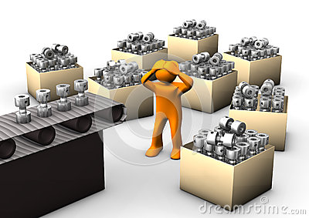
Overproduction (Section 3)
What caused this?: Mass-production leads to increased production
Effects: More products available that were unaffordable. People borrowed money to buy more, increasing debt.

Slide 8
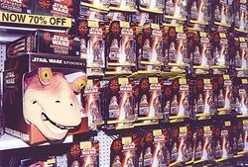
Underconsumption (Section 3)
What caused this?: People too deep in debt to borrow more money.
Effect: Many people stopped buying products.

Slide 9
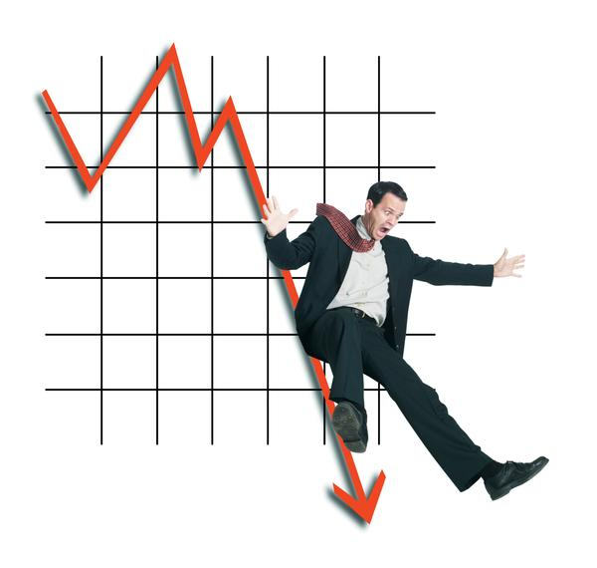
Federal Reserve’s fault (Section 4)
The “Fed” controls how much money is available.
They set interest rates which banks can borrow from them, then loan out to businesses

Slide 10
Federal Reserve’s fault (Section 4)
Low interest rates led to lots of borrowing.
After crash, Feds raised interest rates.
Decrease supply of money.
Businesses can’t get money to pay debts and workers

Slide 11
Hawley-Smoot Tariff (Section 4)
A tariff is a tax on foreign goods.
Makes US goods cheaper
Congress raises tariffs to get more money
Other countries raise tariffs. Stops int. trading.

